Slide 1
Prevention Agenda 2025-2030:
New York State Department of Health’s Recommendation
Public Health Committee
Zahra Alaali, MPH (Pronouns: she/her/hers)
Prevention Agenda Coordinator
Office of Public Health Practice
New York State Department of Health
July 11, 2024

Slide 2
Introduction

Slide 3
Common Acronyms
LHDs: Local Health Departments.
SHA: State Health Assessment.
SHIP: State Health Improvement Plan.
CHA: Community Health Assessment.
CHIP: Community Health Improvement Plan.
CSP: Community Service Plan.
PHAB: Public Health Accreditation Board.
IRS: Internal Revenue Service.
SDOH: Social Determinants of Health.

Slide 4
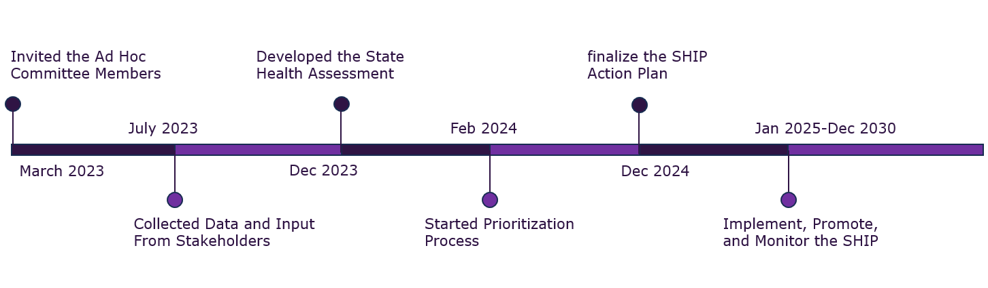
2025-2030 Prevention Agenda Timeline

Slide 5
How Was the 2025-2030 Prevention Agenda Developed?
State Health Assessment
New York State Data Profiles (e.g., birth, death, hospital records, program statistics, U.S. Census, and national survey)
Stakeholder Engagement
Steering Committee made up of subject matter experts from over 38 centers, divisions, and programs across NYSDOH
2019-2024 Prevention Agenda progress
Ad Hoc Committee Includes 120+ representatives from 48 agencies across various sectors beyond health
Local Health Departments and NYS Association of County Health Officials
Non-profit Hospitals and Hospital Associations
State Agencies (e.g.; OMH, OASAS, DOS, NYSOFA and others)
Prioritization
Online survey completed in Feb 2023 (230 participants)
Collected stakeholders feedback on selected priorities
Local Health Departments and Hospitals Plans (112 plans from 58 LHDs and 185 hospitals)
Local agencies and community-based organizations​

Slide 6
Priorities Survey Findings

Slide 7
Weighted Voting Survey
Response Rate 57%

Slide 8
Key Findings
Key Findings
Top Health Concerns: The top priority list encompasses a range of issues, from socioeconomic factors to specific health conditions
  Economic Wellbeing
  Maternal and Child Health
  Mental Wellbeing and Substance Use
  Healthcare Access and Quality
  Safe and Healthy Communities
  Education Access and Quality

Slide 9
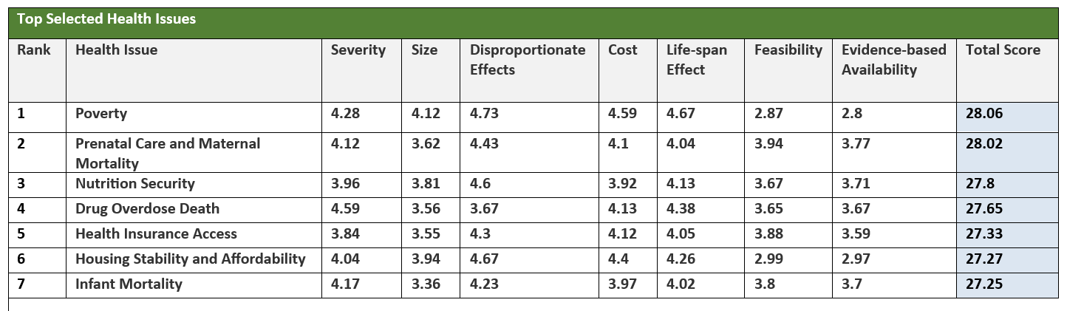
Weighted Voting Survey

Slide 10
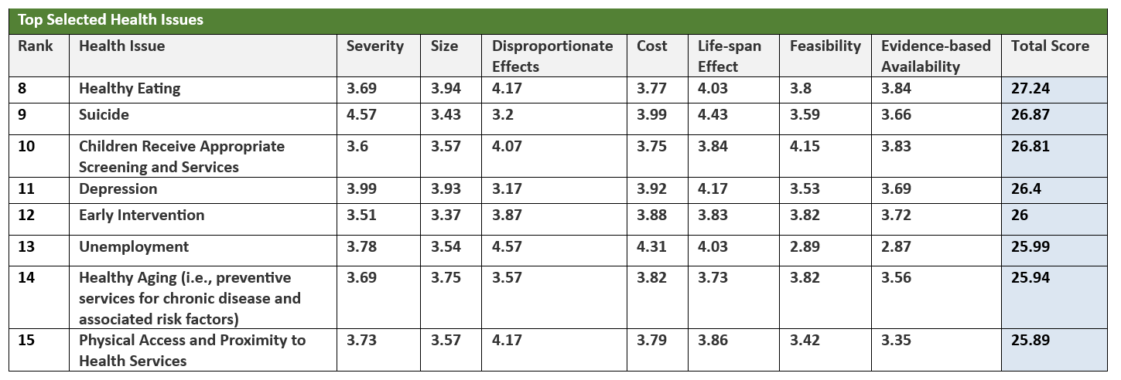
Weighted Voting Survey

Slide 11
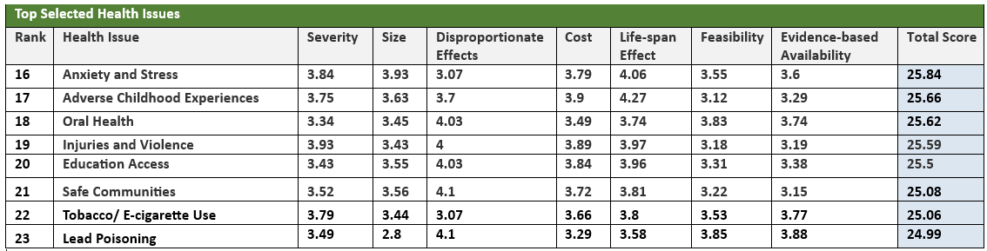
Weighted Voting Survey

Slide 12
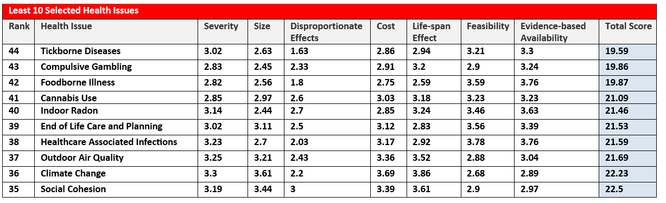
Weighted Voting Survey

Slide 13
Recommendations
The Social Determinants of Health (SDOH) are critical areas of need in New York
Integrate SDOH into the 2025-2030 Prevention Agenda priorities to:
  Address direct and indirect factors influencing health, and
  Reflect needs of the community
  Consistent with approach of Healthy People 2030

Slide 14
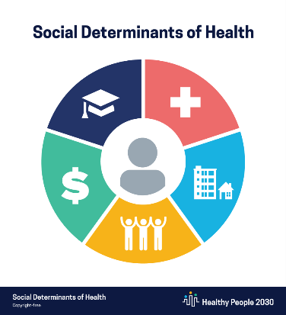
NYS DOH Proposal…
1. Prevent Chronic Diseases
2. Promote a Healthy and Safe Environment
3. Promote Healthy Women, Infants and Children
4. Promote Well-Being and Prevent Mental and Substance Use Disorders
5. Prevent Communicable Diseases
1. Economic Stability
2. Social and Community Context
3. Neighborhood and Built Environment
4. Health Care Access and Quality
5. Education Access and Quality
2019-2024 Prevention Agenda
2025-2030 Prevention Agenda

Slide 15
Why Frame the State Health Improvement Plan Around the Social Determinants of Health?

Slide 16
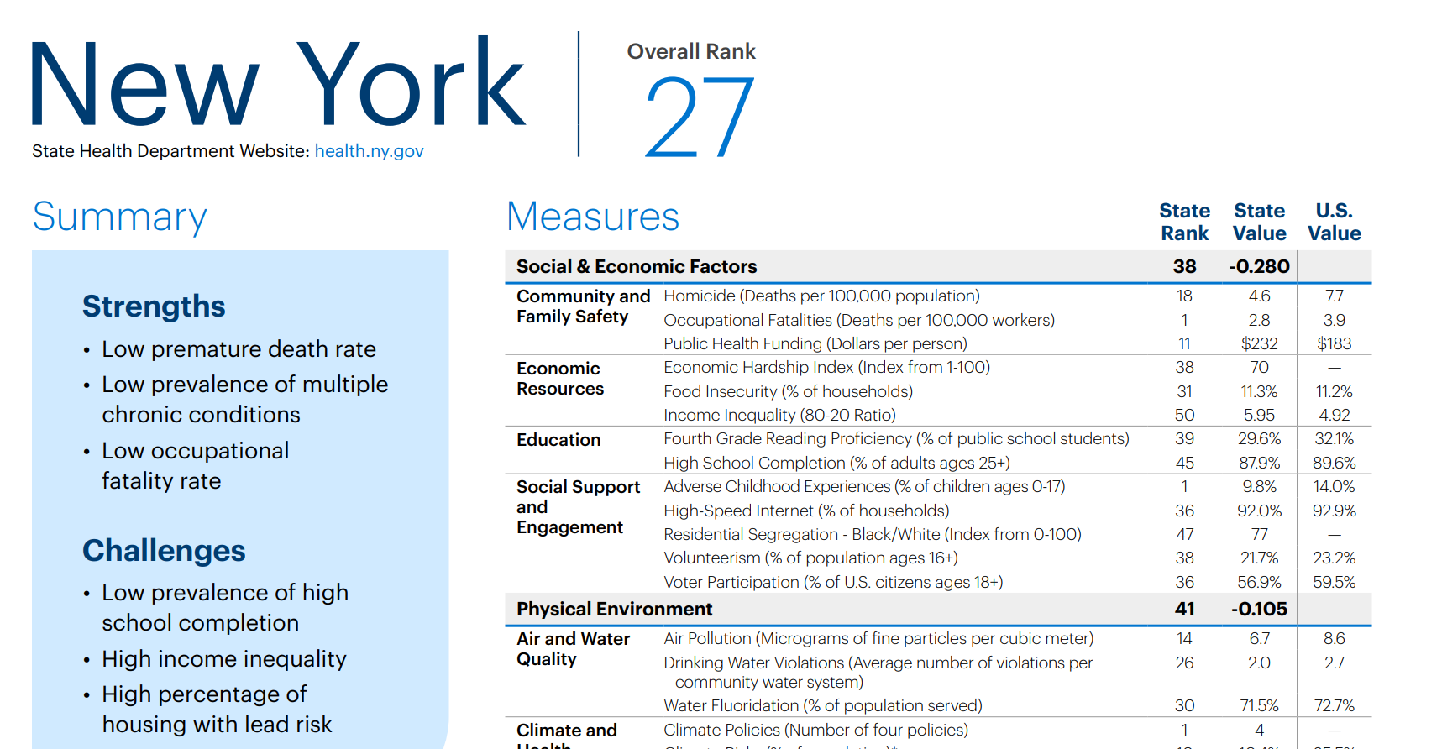
America’s Health Ranking

Slide 17
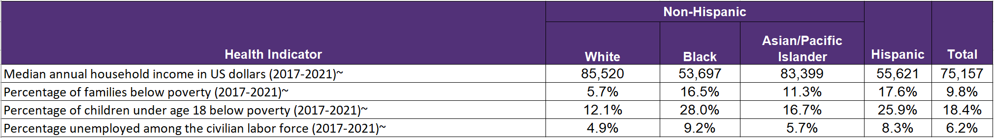
Income, Poverty, and Unemployment by Race/Ethnicity, NYS 2017-2021
~White non-Hispanic, Black (including Hispanic), Asian (including Hispanic, excluding Pacific Islanders), and Hispanic (of any race).
Data Source: New York State County Health Indicators by Race/Ethnicity

Slide 18
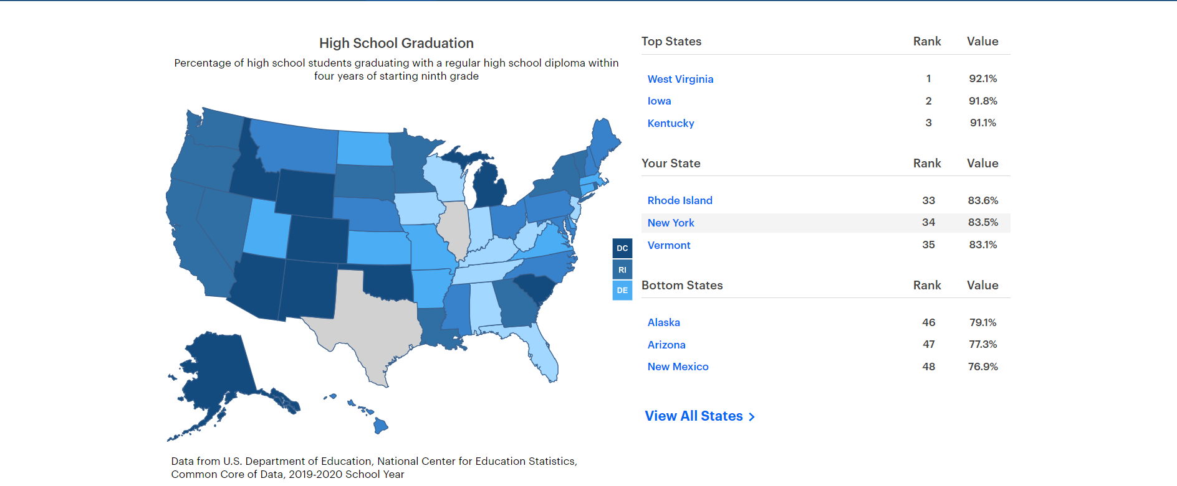
America’s Health Rankings
https://www.americashealthrankings.org/explore/measures/Graduation_A/NY

Slide 19
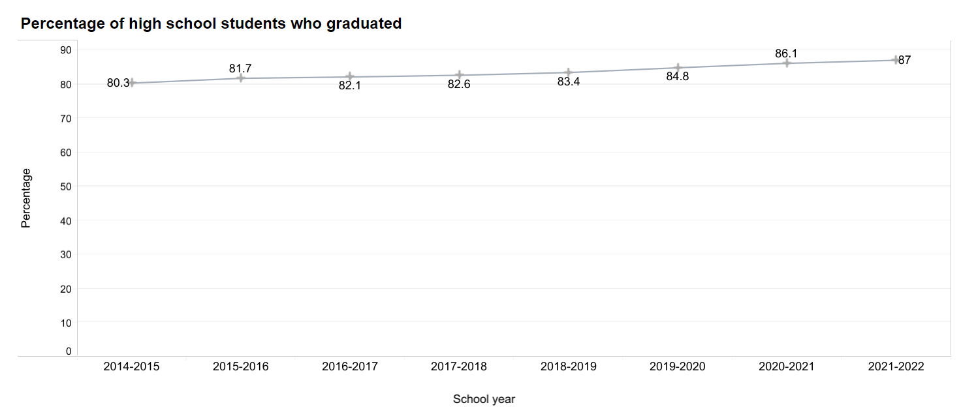
High School Graduation

Slide 20
A SDOH Framework Supports...
Holistic Approach
Addressing Root Causes
Health Equity
Intersectoral Collaboration
Preventive Approach
Community Empowerment

Slide 21
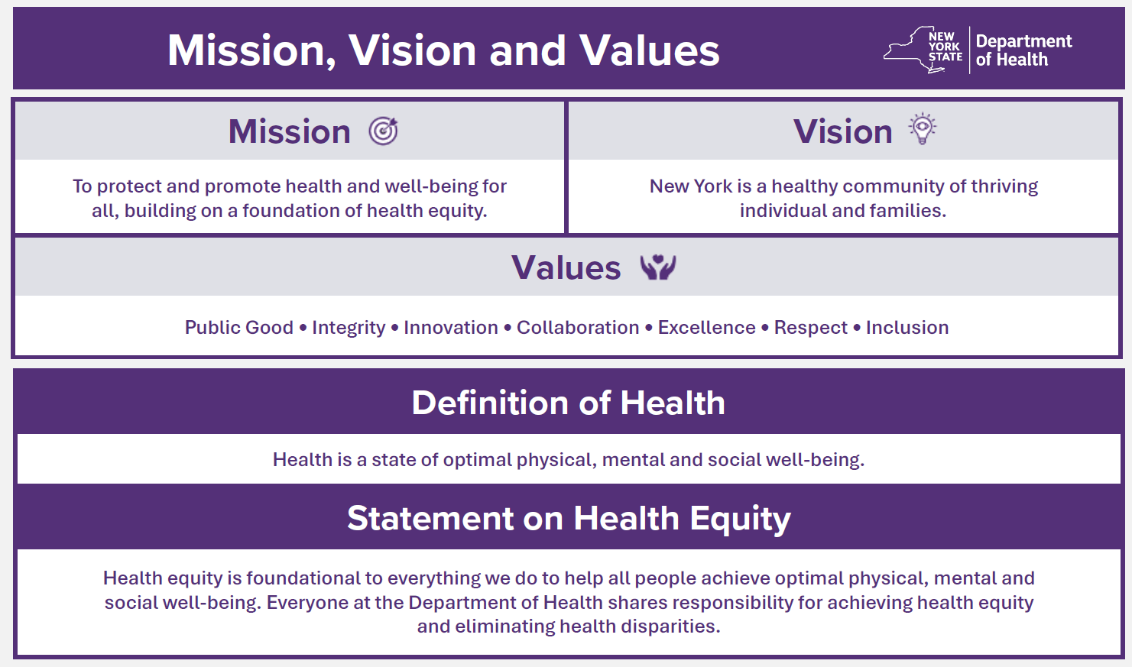
NYSDOH’s Updated Mission, Vision, and Values

Slide 22
Prevention Agenda 2025- 2030

Slide 23
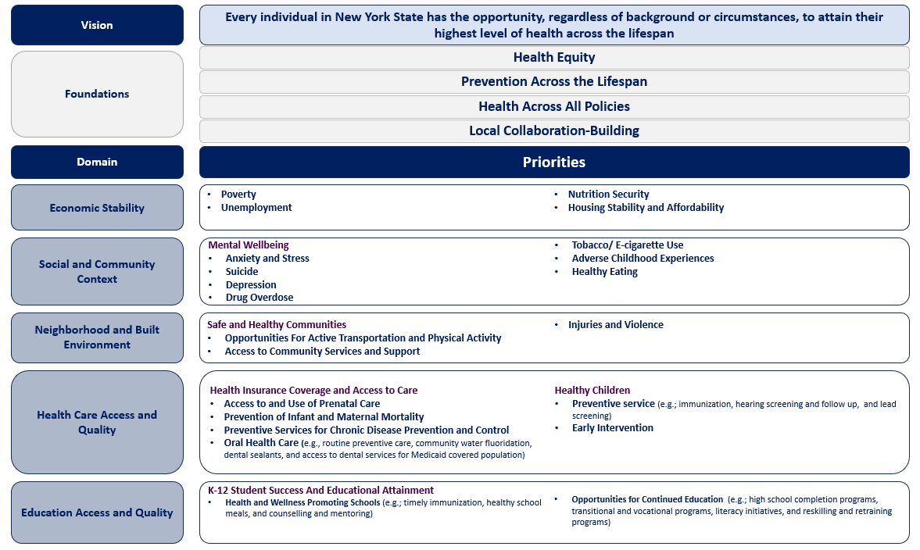
2025-2030 Prevention Agenda Framework
Includes the Top 23 Selected Health Issues

Slide 24
Foundations
Health Equity: Focus on structural racism and implicit bias as social drivers of health.
Prevention Across the Lifespan: Promote health and prevent disease through evidence-based interventions, addressing social determinants and health inequities at every stage of life.
Health in All Policies: Promote an interdisciplinary, multi-sector collaboration.
Local Collaboration-Building: Work collaboratively with stakeholders and community members to achieve SHIP goals.

Slide 25
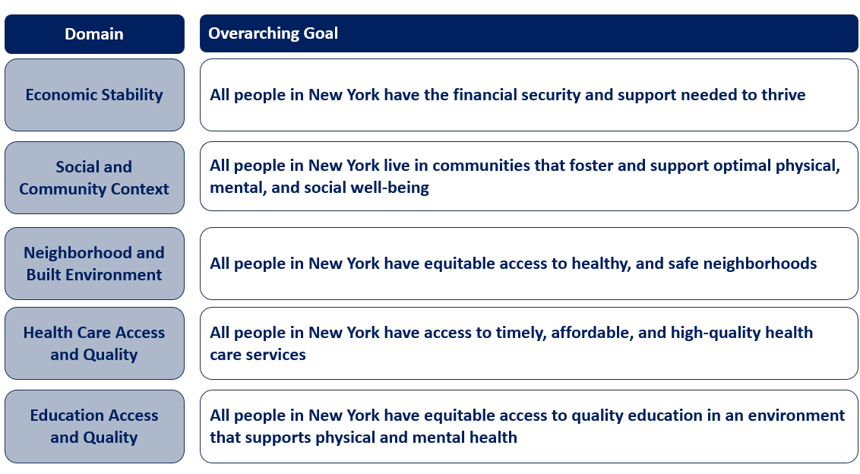
Overarching Goals

Slide 26
Prevention Agenda 2025-2030
Each of the 5 domains will include:
  One overarching goal
  1-3 objectives for each of the priorities
  Indicators to track progress
  Evidence-based interventions
    For hospitals, health departments, and other organizations
    Resources for implementation
    Identification of populations/age groups affected
    Partners/organizations that play leading or supporting roles

Slide 27
Domain Workgroups
Purpose
Identify the goals, objectives, indicators, and interventions for each domain.
Who?
Workgroups are comprised of organizations and members from the Ad Hoc Committee, including NYSDOH programs, LHDs, hospitals, subject-matter experts, and community members.
When?
July- October 2024.

Slide 28
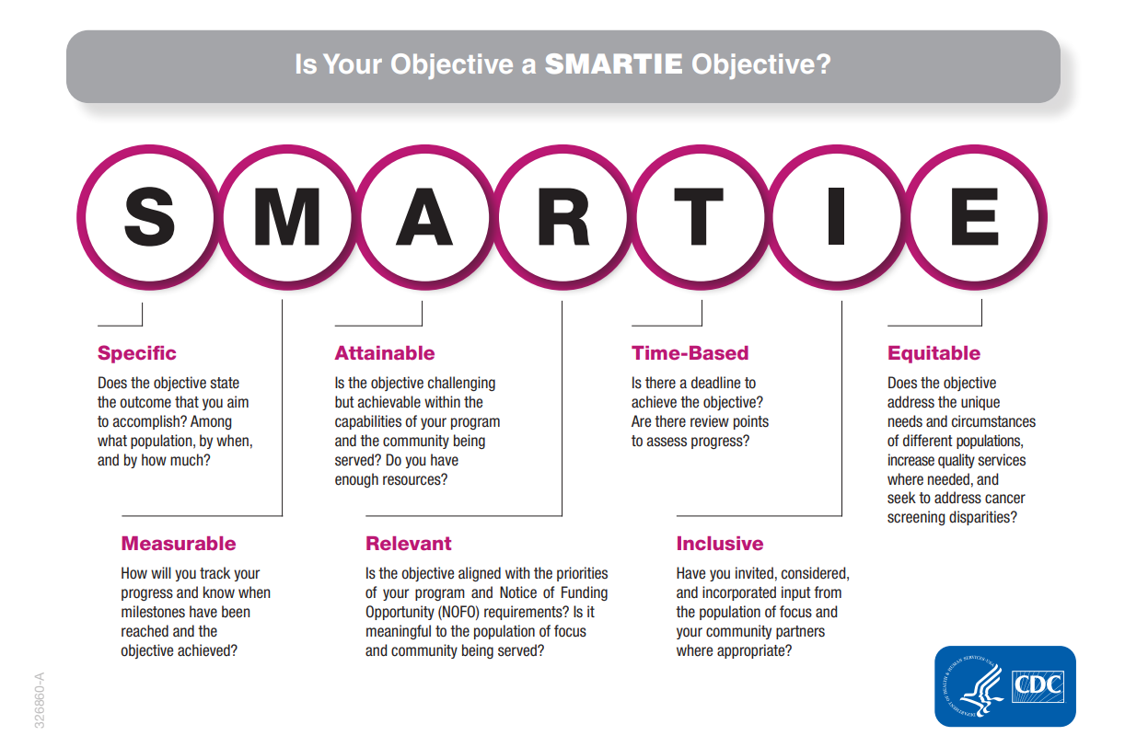
SMARTIE Objectives
The SMARTIE Objectives Framework will be used to ensure that objectives are precise:

Slide 29
Questions Raised…
How can health care organizations effectively address the core issues of social determinants of health?
Are there examples of successful collaborations between local health departments, hospitals, and other local partners?
How will other sectors, state agencies, and stakeholder organizations be engaged to ensure the success of the 2025-2030 Prevention Agenda?
How will consumers be given a voice in the Prevention Agenda going forward?
How can collaborations between local health departments and hospitals be strengthened or formalized?

Slide 30
Examples of Hospitals and Partners Addressing SDOHs

Slide 31
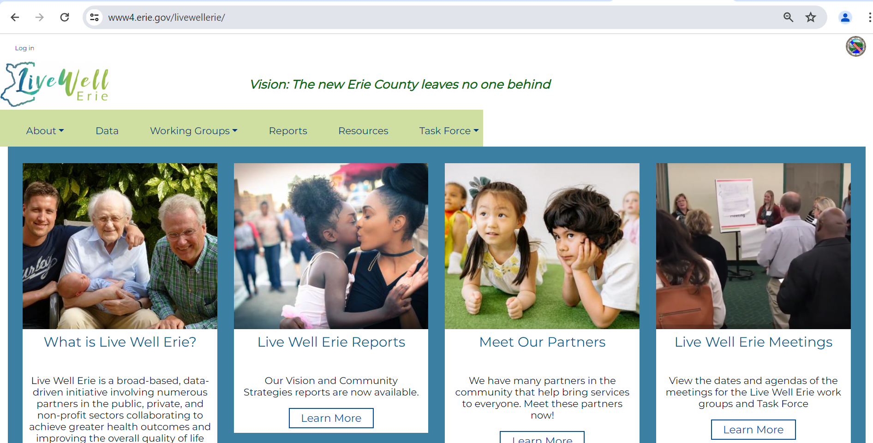
SDOHs
Erie County Health and Human Service Departments
The Live Well Erie Initiative
Location: Erie County.
Partnership with community-based organizations, private, non-profit, academic, and philanthropic sectors.
Focus on: Children, Working Families, Seniors.
Goal: Improving the quality of life for Erie County residents.
Five Guiding Principals:
A clear focus on the social determinants of health;
An integration of the Racial Equity Impact Analysis;
An invitation for innovative thinking;
An opportunity for the modernization of service delivery;
An expectation of partnership and collaboration.
Meaningful improvements in the SDOHs

Slide 32
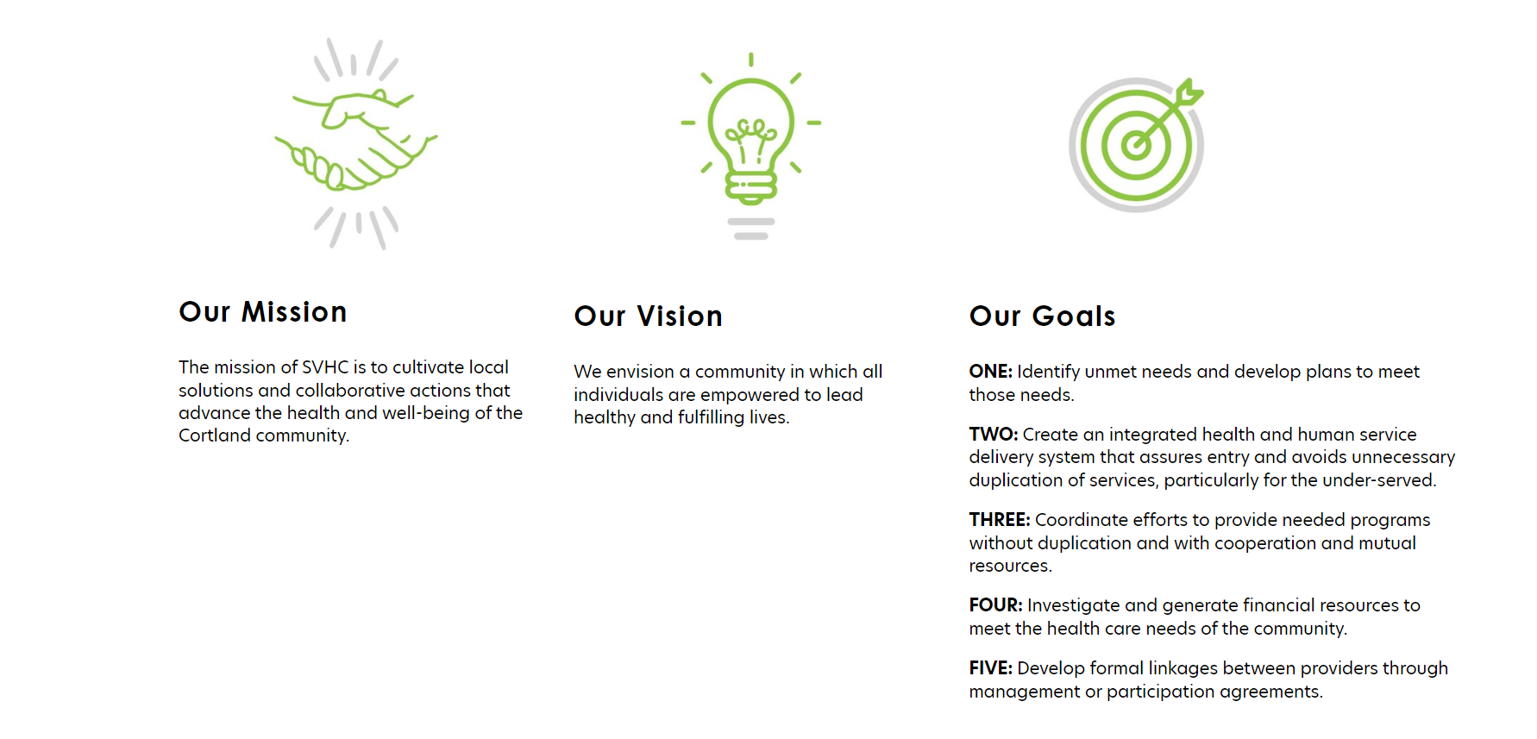
SDOHs
Seven Valleys Health Coalition
Location: Cortland County.
Partnership with Cortland County Health Department, Guthrie Cortland Medical Center, and Family Health Network of Central New York.
Goal: Identify unmet needs and addressing local health issues at a local level.
Services:
Helping people access healthcare services
Providing counseling and education (e.g., prevention and management of chronic health conditions, food waste, oral health, breastfeeding, and others).
2-1-1 CORTLAND

Slide 33
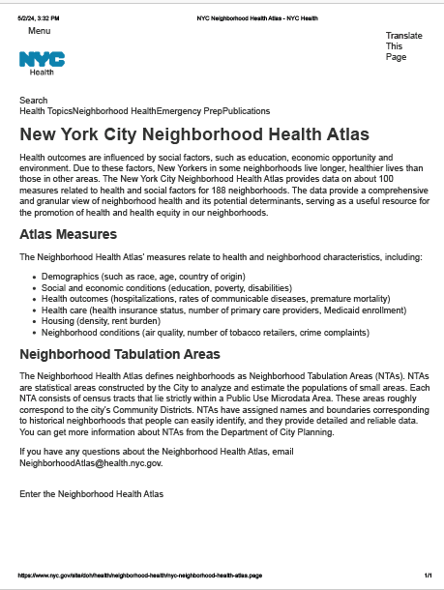
SDOHs
NYC Department of Health and Mental Hygiene
NYC Neighborhood Health Atlas
Location: NYC.
Focus on providing data on about 100 measures related to health and social factors for 188 neighborhoods.
Goal: Promotion of health and health equity in NYC neighborhoods.
Data:
Demographics (such as race, age, country of origin)
Social and economic conditions (education, poverty, disabilities)
Health outcomes (hospitalizations, rates of communicable diseases, premature mortality)
Health care (health insurance status, number of primary care providers, Medicaid enrollment)
Housing (density, rent burden)
Neighborhood conditions (air quality, number of tobacco retailers, crime complaints)

Slide 34

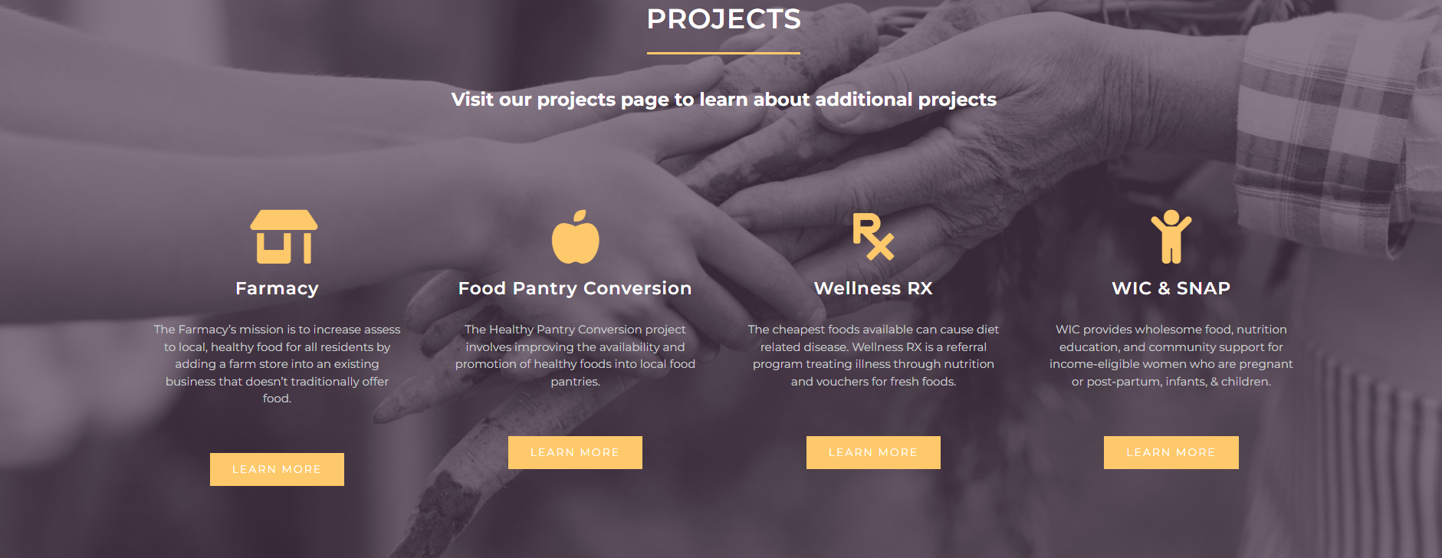
Food Insecurity
Essex County
The Well Fed Essex County Collaborative
Location: Essex County
Partnership with Essex County Health Department, Cornell Cooperative Extension, ADK Action, University of Vermont Health Network, Local Farms, and others
Focus on increasing healthy food access for all people in Essex County, with a focus on vulnerable residents through mutually reinforcing projects.

Slide 35
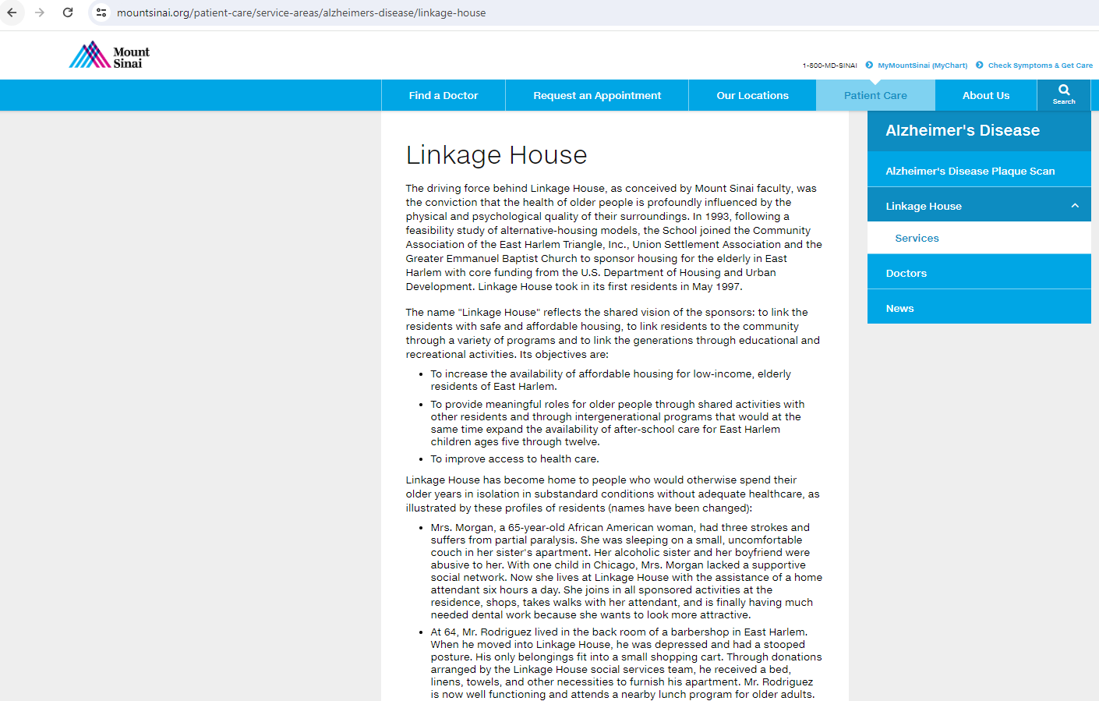
Housing
Mount Sinai
Linkage House
Location: East Harlem.
Partnership with the Community Association of the East Harlem Triangle, Inc., Union Settlement Association, and the Greater Emmanuel Baptist Church.
Focus: low-income, elderly, and people with Alzheimer in East Harlem.
Services:
  Link the residents with safe and affordable housing.
  Provide access to quality health care, educational programs, and recreational activities.

Slide 36
Current Vs New Prevention Agenda

Slide 37
How Will the 2025 -2030 SHIP Be Implemented?
The SHIP menu of objectives, strategies and approaches provides flexible options for all communities to improve outcomes for New Yorkers of all ages.
State and Local Partners:
Many partners at the state and local level contribute to achieving the vision of the Prevention Agenda, including:
Public and private partners must work together to achieve Prevention Agenda goals
Local health departments
Hospitals
State agencies
Statewide organizations
Healthcare Providers
Community behavioral
health providers
Housing organizations
Medicaid managed care plans
Philanthropy
Schools
Local agencies and community-based organizations

Slide 38
How Will the 2025 -2030 SHIP Be Implemented?
SHIP strategies will be implemented as part of:
  Community health improvement efforts led by local health departments
  Hospital activities, investments and community benefit expenditures
  Actions and investments by other community partners.
  New York’s Certificate of Need (CON)
Strengthen collaboration between hospitals and local health departments
  Ensure stronger alignment of hospital community investments and local health department priorities.
Establishing cross-sector partnerships:
  Implement strategies and interventions to advance the Prevention Agenda and improve the health of individuals of all ages
  Identify assets, resources, and evidence-based or best-practice interventions

Slide 39
Cycle | 2019-2024 | 2025-2030
Time | 6years | 6 years
Focus | Major public health areas with a focus on addressing disparities and promoting health equity | Health Equity
Objectives | SMART | SMARTIE
Submission Cycle | Every three years for both LHDs and hospitals | LHDS every 6 years Hospitals every 3 years (per federal requirement)
Priority Selection | Two Prevention Agenda priorities with one focus area each, or one priority with two focus areas One priority must address a disparity and promote health equity | Three priorities under one or more SDOH domain
Collaboration | Hospitals must align priorities with the county LHD Encouraged joint CHAs/CHIPs/CSPs | Hospitals must align priorities with the county LHD Encouraged joint CHAs/CHIPs/CSPs Involvement of local communities in assessment, selection, design, prioritization, and implementation
Interagency Collaboration | Ad Hoc (interagency workgroup)- Planning the Prevention Agenda | Ad Hoc (interagency workgroup)- Planning the Prevention Agenda Developing interagency workgroup to address SDOHs

Slide 40
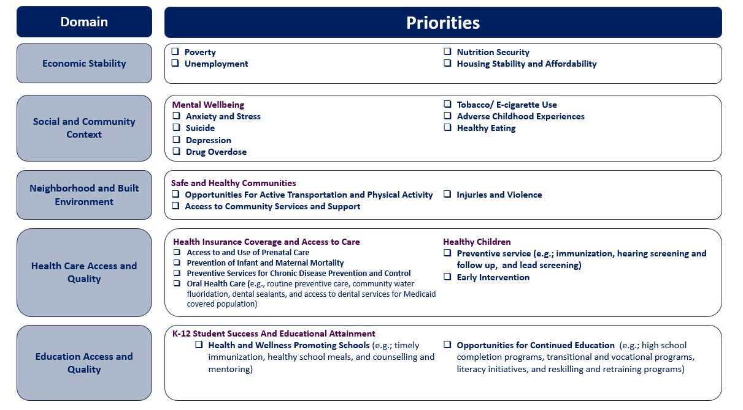
Priorities Selection Example
Three priorities under one SDOH domain

Slide 41
Priorities Selection Example
Three priorities under different SDOH domains

Slide 42
SDOH Interagency Workgroup

Slide 43
SDOH Interagency Workgroup
Establishment and Proposed Timeline
Purpose
Promote a government culture that prioritizes health and equity for New Yorkers across policy areas.
Incorporate health and equity into state agency practices.
Provide a forum for agencies to identify shared goals and opportunities to enhance performance through collaboration.
Who?
Explore opportunities for existing interagency councils to create a working group to perform this function.

Slide 44
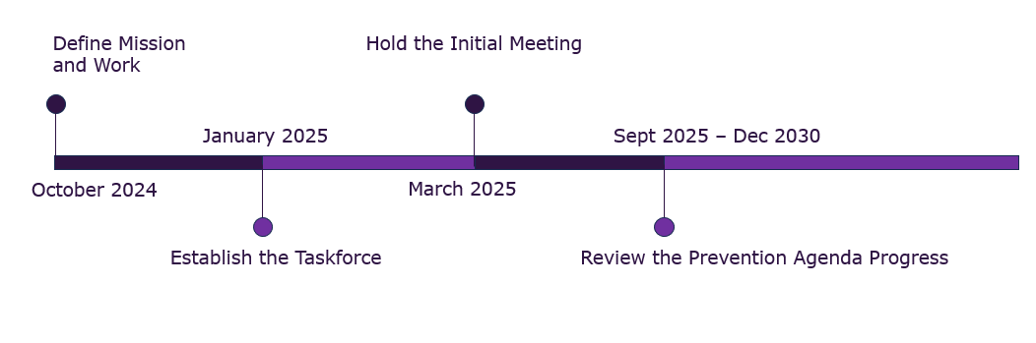
SDOH Interagency Workgroup
Establishment and Proposed Timeline

Slide 45
Questions?
Please contact us at prevention@health.ny.gov

Slide 46
Appendix

Slide 47
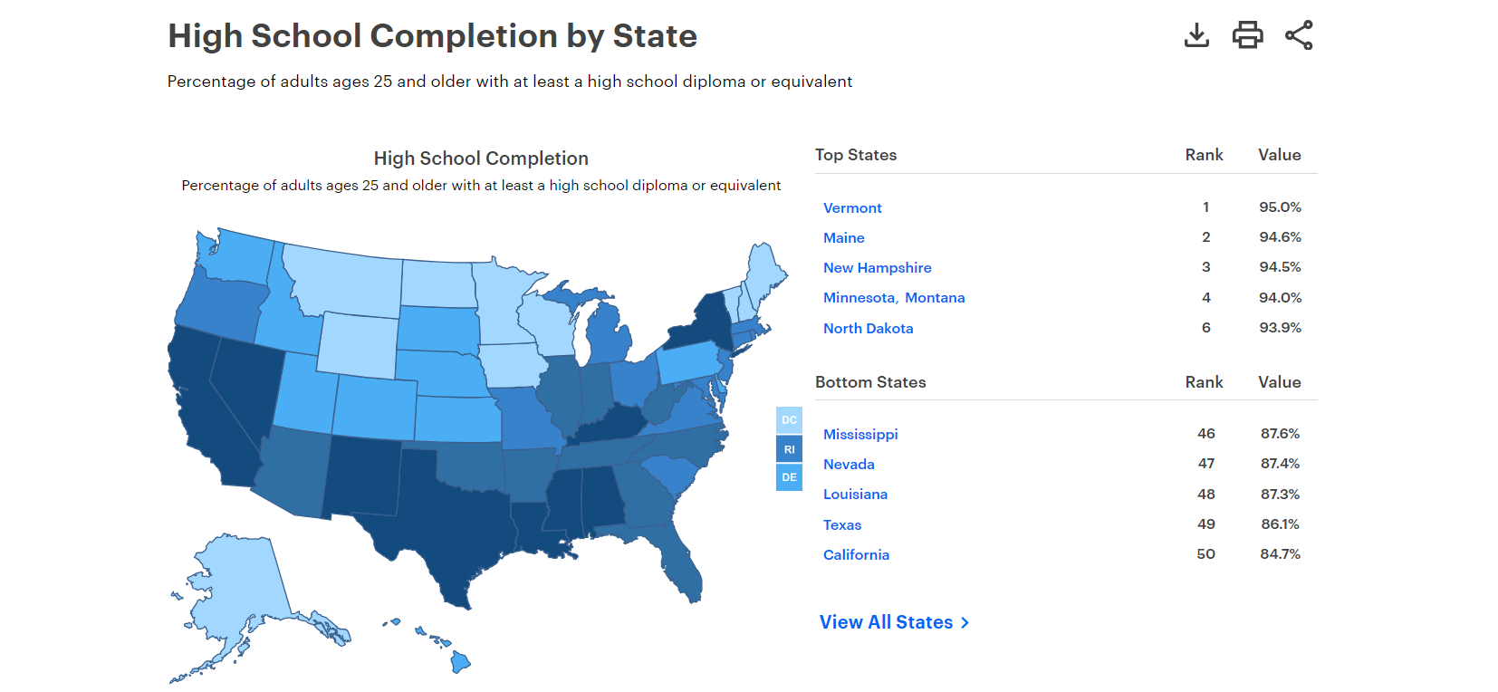
America’s Health Rankings
https://www.americashealthrankings.org/explore/measures/hs_completion/NY

Slide 48
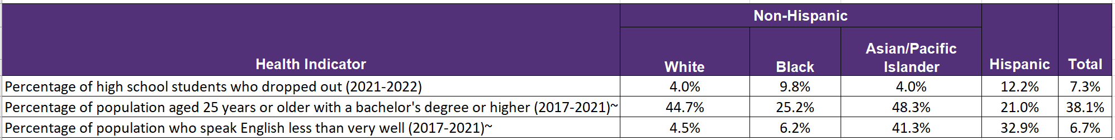
Selected Education Access and Quality Metrics, By Race and Ethnicity, NYS
Data Source: NYS County Health Indicators by Race and Ethnicity

Slide 49
Weighted Voting Survey
Purpose: To help prioritize the 44 public health issues proposed for
inclusion in the 2025-2030 Prevention Agenda.
Method:
Weighted Voting Survey based on seven criteria.
Weights allow to examine data in a way that includes the responses of every single person who answered a question.

Slide 50
Weighted Voting Survey
Criterion 1: Severity of the Problem
Refers to whether the identified issue can reduce life quality, limit opportunities, or cause serious health outcomes such as disability or death.
Criterion 2: Size of The Problem
Refers to whether the identified issue affects a large number of individuals and has the potential for a significant impact on the health of the community.
Criterion 3: Disproportionate Effects Among Subgroups
Refers to worse health outcomes caused by the issue in specific subgroups, defined by age, race, ethnicity, income, gender, or geography, compared to others.
Criterion 4: Economic and Social Cost
Refers to the consequences of not addressing the issue, which include increased monetary costs (i.e., healthcare and social service expenses) and social costs (i.e., loss of productivity, reduced quality of life, etc.)

Slide 51
Weighted Voting Survey
Criterion 5: Life-span Effect
Refers to a health issue arising at a certain life stage having the potential for lasting impacts and/or serving as a proxy for other related behavioral or social problems.
Criterion 6: Feasibility
Refers to the practicality and adequacy of logistics, including the cost, resources, and interventions needed for the state to effectively address the issue.
Criterion 7: Availability of Evidence-Based Interventions
Refers to whether evidence-based interventions or strategies to prevent or manage the health issue are available and can be implemented with relative ease.

Slide 52
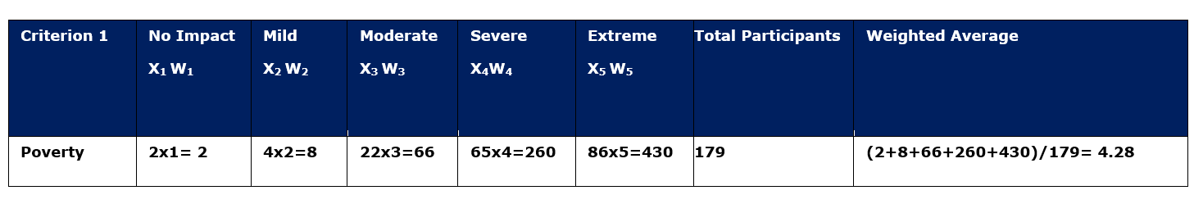
Weighted Voting Survey
How to Calculate the Total weighted Average Score?
The rating average is calculated as follows, where:
(x1w1 + x2w2 + x3w3 ... xnwn) / Total number of Responses
w = weight of answer choice
x = response count for answer choice

Slide 53
Survey Results- Rank of All Health Issues

Slide 54
Weighted Voting Survey
Limitations
Response Rate
Subjectivity in Weight Assignment
Non-response Bias

Slide 55
Poverty
Interventions/ Strategies
Hospitals
Partner with local nonprofits to integrate economic services such as financial coaching, tax preparation, and economic bundles into the medical home and clinics. Incorporate strategies to screen patients for resource insecurities and social needs and connect patients to community resources. Use Data to Identify disparities across patient groups.
Health Departments
Other Organization

Slide 56
Poverty
Interventions/ Strategies
Hospitals
Health Departments
Increase access to and utilization of financial aid programs for low-income families (i.e., child care subsidies and tax credits). Collaborate with local nonprofits and financial institutions to develop strategies that encourage long-term savings and investment account usage (i.e., Children's Savings Accounts and baby bonds). Maintain, sustain, expand policies and systems that address income security with respect to key living expenses (e.g., housing, taxes, childcare, health care).
Other Organization

Slide 57
Poverty
Interventions/ Strategies
Hospitals
Health Departments
Other Organization
Collaborate with local, state, and national governments to integrate health into all policy-making. Partner with healthcare providers to deliver home- and community-based services and other evidence-based services for older adults. Increase the capacity of CBO staff members to use evidence-based programs (EBPs) in communities experiencing health disparities. The intervention included a workshop, ongoing capacity-building supports like a customized web portal, resources, networking events, mini-grants, and technical assistance.

Slide 58
Unemployment
Interventions/ Strategies
Hospitals
Incorporate strategies to screen patients for resource insecurities and social needs and connect patients to community resources. ¹ Connect volunteer services to patients needing employment resources. ¹ Develop relationships and ongoing communication with local employment specialists and organizations. ¹ Use Data to identify disparities across patient groups.² Create pathways utilizing existing resources to link patients seeking employment to obtain assistance from external agencies. ¹
Health Departments
Other Organization

Slide 59
Unemployment
Interventions/ Strategies
Hospitals
Health Departments
Develop relationships with community-based organizations that connect those facing unemployment with state and local resources or benefits. ¹ Facilitate relationships between healthcare organizations and employment services organizations. ¹ Engage with and maintain policies that align with equitable employment legislation. ²
Other Organization

Slide 60
Unemployment
Interventions/ Strategies
Hospitals
Health Departments
Other Organization
Collaborate with local, state, and national governments to integrate health into all policy-making. ¹ Partner with health departments and healthcare settings to develop advocacy and service programs that improve access to employment. ² Build relationships with other local organizations that advocate for equitable and accessible employment for community members. ²

Slide 61
Housing Stability and Affordability
Interventions/ Strategies
Hospitals
Partner with local organizations to create pathways for referrals to permanent supportive housing and other alternative housing sources. ¹ Incorporate strategies to screen patients for resource insecurities and social needs, and connect patients to community resources such as permanent supportive housing or other alternative housing services. ^{1, 2} Offer trauma-informed care training for staff to effectively provide referrals/interventions for patient populations experiencing homelessness. ³ Use Data to Identify disparities across patient groups. ⁴
Health Departments
Other Organization

Slide 62
Housing Stability and Affordability
Interventions/ Strategies
Hospitals
Health Departments
Develop relationships with community-based organizations that facilitate permanent supportive housing to those dealing with housing instability. ¹ Collaborate with state Medicaid agency to reduce housing instability and increase access to healthcare services. ² Partner with healthcare facilities to foster accessible programs and appropriate resources for people experiencing housing instability. ¹
Other Organization

Slide 63
Housing Stability and Affordability
Interventions/ Strategies
Hospitals
Health Departments
Other Organization
Collaborate with local, state, and national governments to integrate health into all policy-making. ¹ Increase staff capacity to utilize trauma-informed models of care when working with patients/clients experiencing housing instability. ² Build relationships with healthcare facilities, health departments, and other local organizations to increase access to resources for people experiencing housing instability. ³

Slide 64
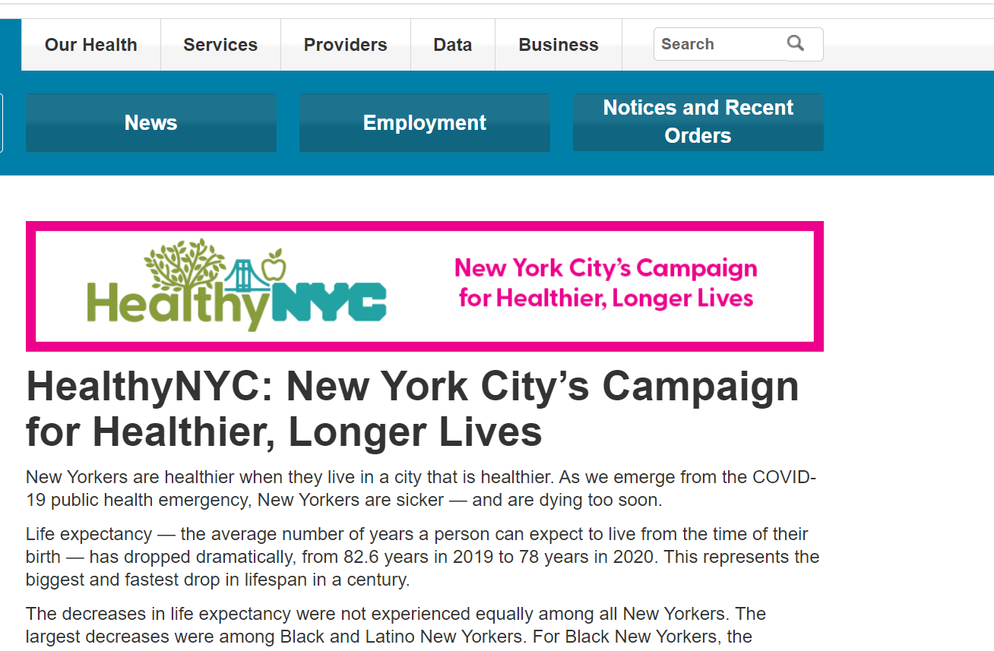
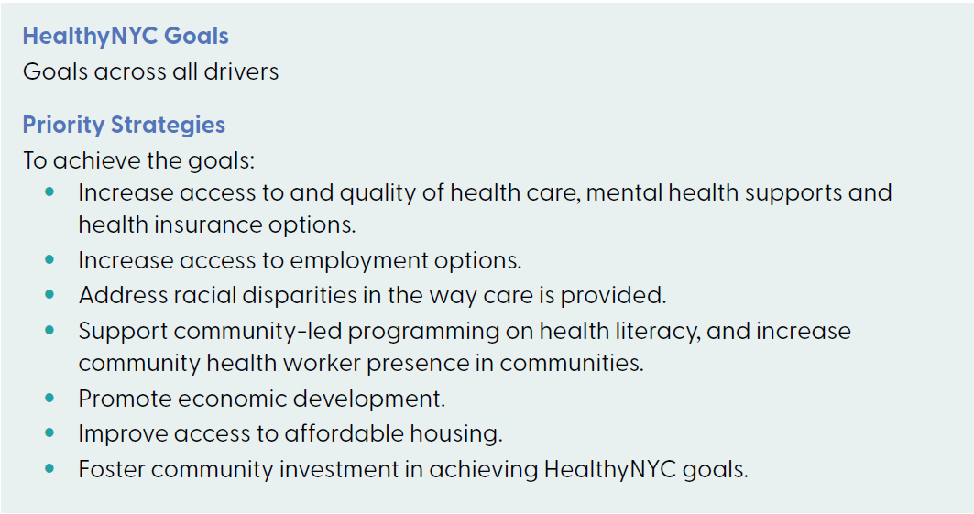
SDOHs
NYC Department of Health and Mental Hygiene
HealthyNYC Campaign
Location: NYC.
Partner with City agencies, health care institutions, private and nonprofit businesses, community- and faith-based organizations, state and federal leadership, and other.

Slide 65
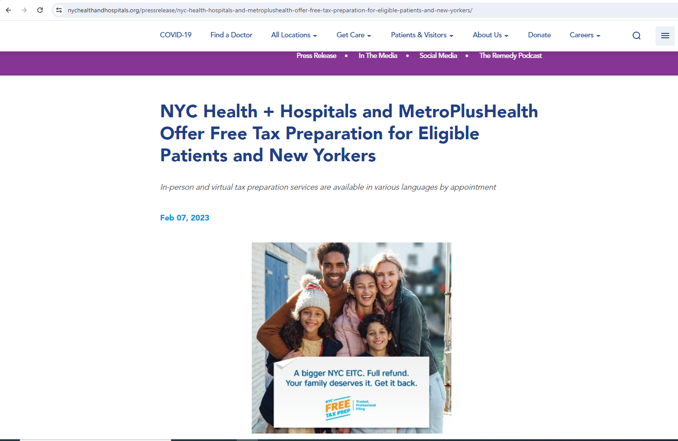
Poverty Intervention
NYC Health + Hospitals
Department of Consumer and Worker Protection’s (DCWP) NYC Free Tax Prep initiative
Location: Multiple Locations in Bronx, Brooklyn, Manhattan, and Queens.
Partnership with BronxWorks, Grow Brooklyn, Urban Upbound, and Code for America’s GetYourRefund initiative
Focus on: New Yorkers who earned <$56,000 or less and are filing on their own or families who earned $80,000 or less.
Service: virtual and In-person tax preparation.

Slide 66
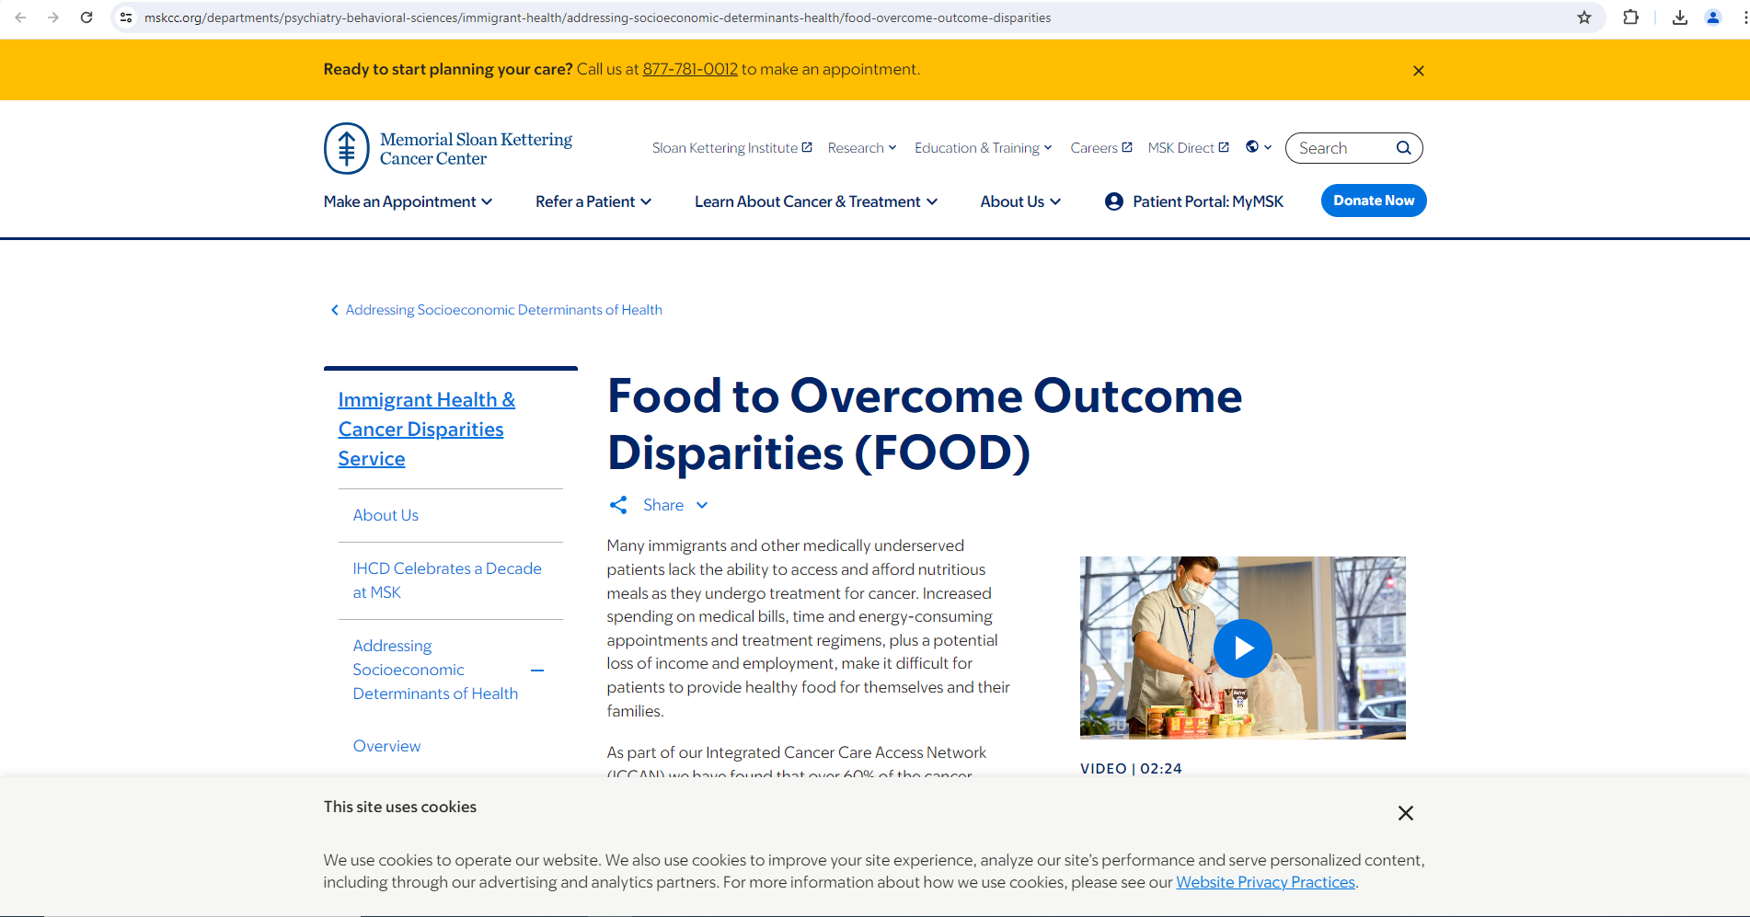
Food Insecurity
Memorial Sloan Kettering Cancer Center New York
Food to Overcome Outcome Disparities (FOOD)
Location: 13 pantries co-located in cancer clinics serving patients in Manhattan, Queens, Brooklyn, the Bronx, and Long Island.
Partnership with NYC Food Bank, New York Common Pantry, Green Bronx Machine, and others.
Focus on: Patients with Cancer.
Services:
  Free Food Distribution: Offers fresh fruits, vegetables, and healthy options low in sodium and sugar to help patients manage chronic conditions.
  Provider Training Course: Educates healthcare providers on the importance of addressing food insecurity in clinical interactions with patients.

Slide 67
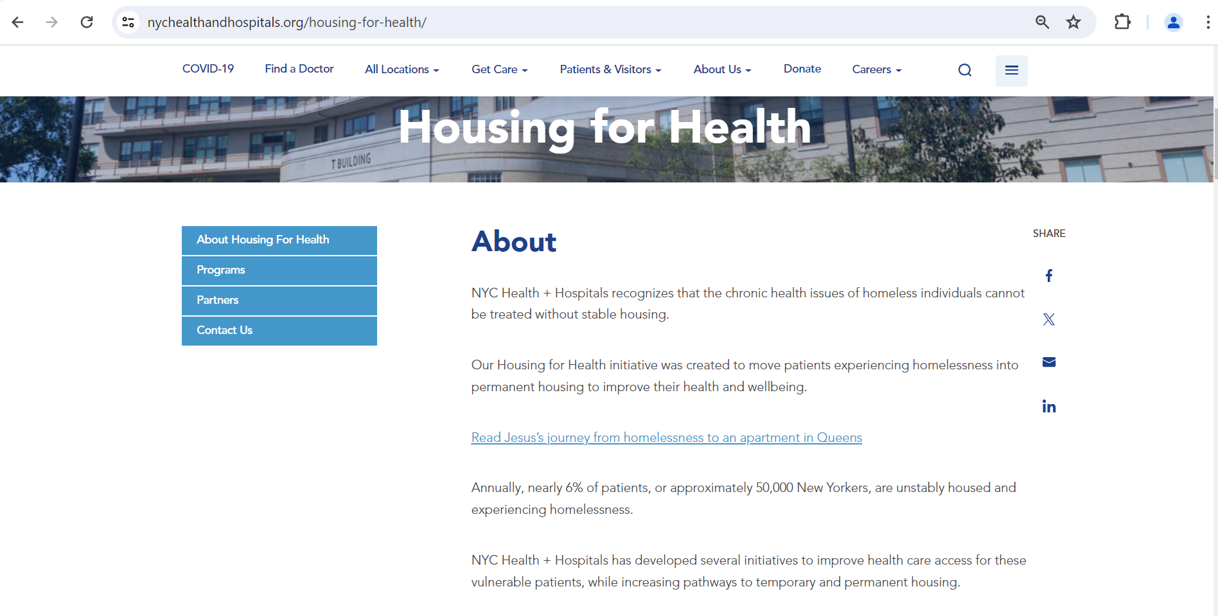
Housing
NYC Health + Hospitals
Housing for Health
Location: East Harlem.
Partnership with community-based organizations, City and State housing and homelessness agencies, NYC Housing Development Corporation, NYC Department of Social Services, and others.
Focus on: Patients experiencing homelessness.
Services:
  Offer temporary housing for patients experiencing homelessness who have been discharged from an acute care facility but still need specialized care not available in shelters.
  Provide personalized support to assist patients in finding and applying for permanent housing that meets their specific needs.

Slide 68
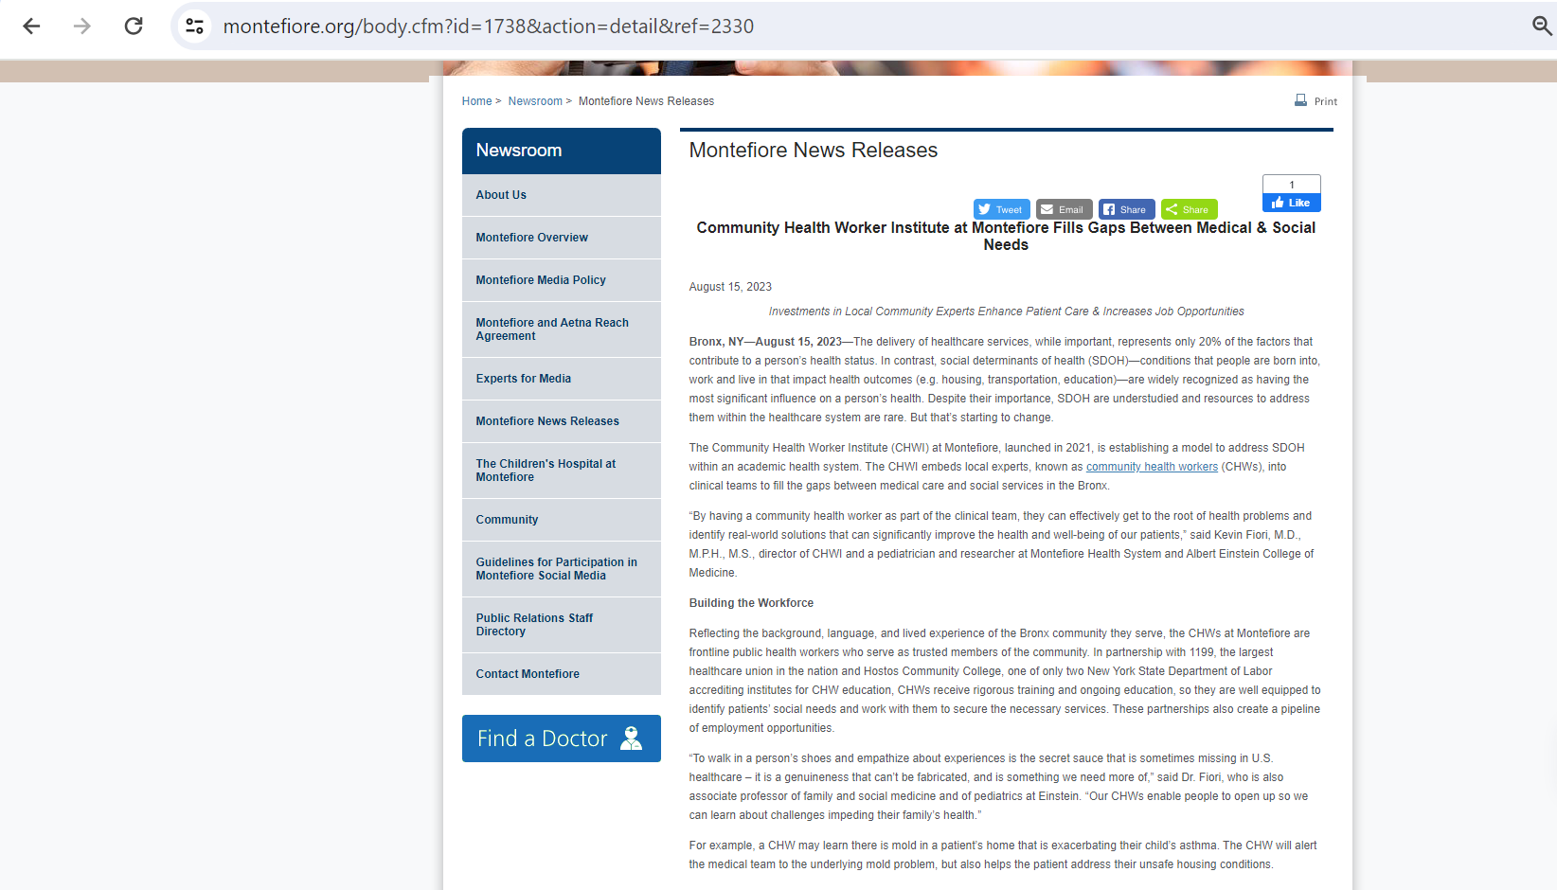
Employment/Education
Montefiore Medical Center
Community Health Worker Institute (CHWI)
Location: Bronx.
Partnership with 1199 healthcare union and Hostos Community College
Services:
  Provide training and education to CHWs
  Conducts research on SDOH and the impact of CHWs
    Gather and analyze data on SDOH and health status.
CHWI enhances Patient Care & Increases Job Opportunities

