Slide 1
Workforce Priority Presentation
PHI Grant – Human Resource Engagement, Regional Office & Local Health Department Updates
July 11, 2024

Slide 2
OPH Workforce Team
Public Health
Continuing Education Unit
Program Leadership & Management
Health, Wealth and Wellbeing Unit
Strategic Partners Spotlight:
Human Resources
Liaisons:
Academic, LHD,
Regional Offices
Community
Engagement Unit Leadership

Slide 3
Collaboration and Engagement
Recruitment
Job Descriptions
Workforce Development
Partnering with the training and development unit
New internship opportunities
Engagement
New venues to promote positions (ex. academic institutions, community events)
Collaborative approach to tabling at Career Events
New Titles (HRI)
Review the recruitment cycle

Slide 4
Joint Collaborations
Health Research Inc.
Human Resource Management Group (NYSDOH)
Public Health Infrastructure Grant

Slide 5
Strengthening Public Health Infrastructure
Office of Health Equity and Human Rights
Albany School of Public Health
Cornell University
Department of Health
Community Partners
Notes:
It takes a village to strengthen our public health infrastructure. Each one of the partners on the screen have supported the implementation of the grant and . These partnerships include training and development, technical assistance, interdepartmental collaborations, and our community-based partners. This grant will not be successful without the support of all these partners and more to be named in the future.

Slide 6
Regional Office Updates
July 2024

Slide 7
Anticipated Goals and Outcomes
Strengthen the capacity of OPH, the Regional Offices, and the Local Health Departments.
Improve organization processes and systems, increase hiring of diverse staff that more closely represent the state’s population, progress toward a more modern and efficient data infrastructure, and engage communities across NYS in public health program development.
Implement long-term public health solutions, have staff feel fulfilled in their roles, establish a stronger and better equipped workforce with expanded capacity that will address long-term public health challenges, engage communities, ensure that there is readily available data to make informed decisions to reduce health disparities and inequities affecting our communities.

Slide 8
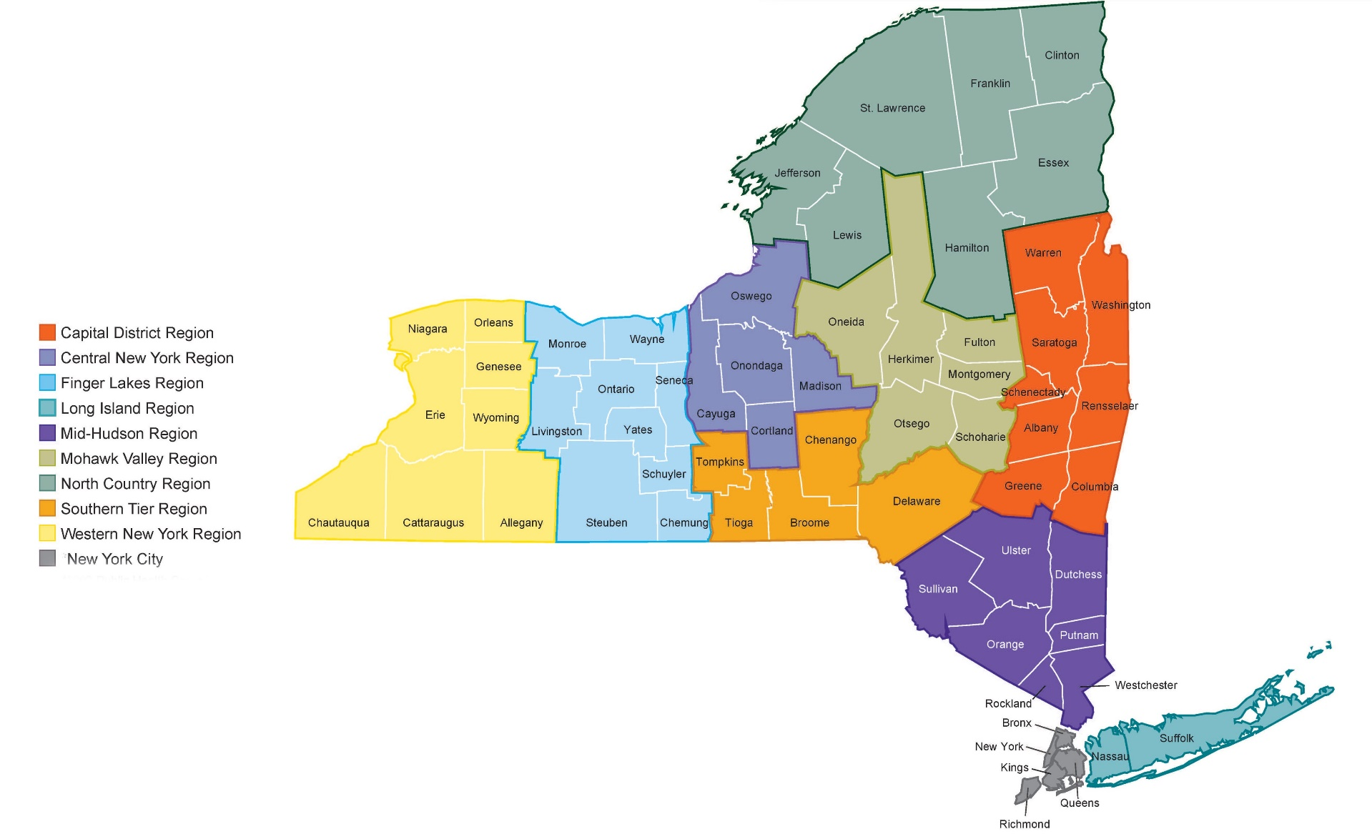
Regional Office Locations
Western NY Regional Office
Central NY Regional Office
Capital District Regional Office
Metropolitan Area Regional Office
Metropolitan Area Regional Office

Slide 9
Regional Office PHI Grant Staff
Capital District
Program Manager
Data Analyst II
Computer Systems Manager
Health Program Administrator II
Public Health Nurse
Public Health Nurse
Public Health Representative II Emergency Preparedness
Public Health Representative IV (CEH)
Administrative Assistant
Community Outreach Specialist (OPH)
T&C Specialist (OPH)
Central
Program Research Specialist III
Public Health Nurse
Public Health Nurse
Public Health Representative IV (CEH)
Community Outreach Specialist (OPH)
T&C Specialist (OPH)
Metropolitan
Public Health Nurse
Public Health Nurse
Public Health Nurse
Assistant Engineer (CEH)
Public Health Representative IV (CEH)
Senior Program Coordinator
Community Outreach Specialist (OPH)
T&C Specialist (OPH)
Western NY
Data Analyst 2
Public Health Nurse
Public Health Nurse
Assistant Engineer (CEH)
Public Health Representative IV (CEH)
Senior Program Coordinator
Community Outreach Specialist (OPH)
T&C Specialist (OPH)

Slide 10
Regional Office Recruitments as of 6/2024
Capital District: 3
Central NY: 3
Western NY: 2, 1 position in process
MARO: 4 positions in process
Summer Internship placements within the Regional Offices: 3 CNY, 1 WNY

Slide 11
Staffing in Regional Offices
PHI Grant recognizes importance of increasing job opportunities statewide. Collaboration with Regional Offices to embed PHI staff within Regional Office locations.
Community Engagement & Outreach Unit
Assistant Director, Community Engagement
4 Outreach Specialists
Public Health Continuing Education Unit
4 Training & Communication Specialists

Slide 12
Local Health Department (LHD)
Updates
July 2024

Slide 13
Anticipated LHD Outcomes
This investment in the local public health workforce and the foundational capabilities of LHDs addresses weaknesses in the public health system and strengthens preparedness to address new challenges and future public health emergencies.
Short-term outcomes:
Improvements to the LHD workforce to include hiring new or filling vacant public health positions;
Retaining current public health staff through various investments or services; and
Improving foundational public health capabilities through training and other public health staffing enhancements
Long-term outcomes:
Improvements in the public health of the jurisdiction, especially among socially and economically marginalized communities

Slide 14
LHD Investment
40% of PHI Grant funding ($43,115,335) dedicated to 57 LHDs outside NYC
56 LHDs contracted
Year 1 – Year 2 (current): 47 approved LHD budget modifications
LHDs have various options to deploy funds-
Hiring new public health staff
Public health staff retention and job satisfaction efforts
Increasing Foundational Public Health Service capacity
Strengthening capacity to address health inequities and disparities

Slide 15
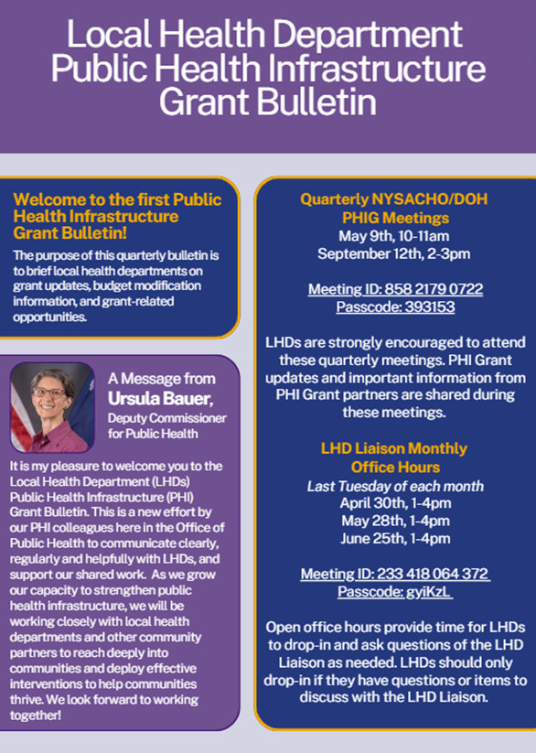
LHD Engagement
Increase in LHD engagement through-
Quarterly email bulletins
Monthly, open office hours
TA calls by request
Quarterly meetings (in partnership with NYSACHO)
Resource guides

Slide 16
LHD PHI Grant Expenditure Resource Guide

Slide 17
LHD PHI Grant Expenditures
Expenditure | # of LHDs | Expenditure | # of LHDs
Conference attendance and trainings | 20 | Software and websites/apps | 8
Office furniture improvements | 18 | Building improvements | 6
Salary & fringe, new position | 16 | Miscellaneous equipment | 4
Technology upgrades (ex. new computer equipment) | 15 | Tuition reimbursement | 3
Retention payments, longevity payments, wellness payments, stipends | 9 | Job recruitment efforts | 3
Salary & fringe, existing position | 8

Slide 18
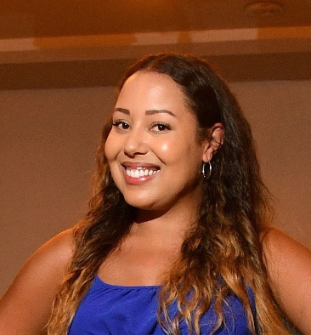
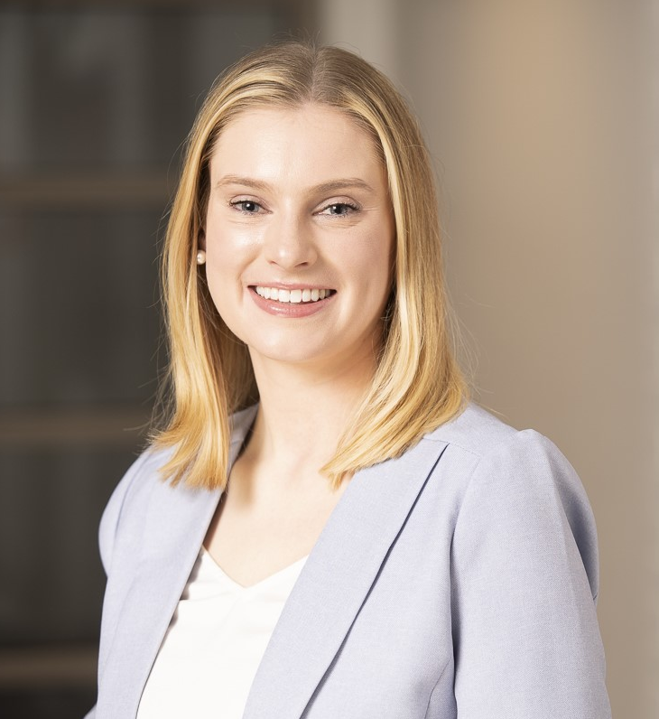
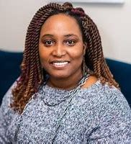
NYSDOH PHI Grant RO/LHD Contacts
Deb Brown
Deborah.Brown@health.ny.gov
Regional Office Liaison,
OPH, Public Health Infrastructure
Keshana Owens-Cody
Keshana.Owens-Cody@health.ny.gov
Workforce Director,
OPH, Public Health Infrastructure
Meredith Patterson
Meredith.Patterson@health.ny.gov
LHD Liaison,
OPH, Public Health Infrastructure
July 2024

Slide 19
Questions?
July 2024

