Slide 1
Financing Long-Term Care:
Challenges, Opportunities and Financing Alternatives
Presented to:
New York State Long Term Care Planning Project
By
Marc A. Cohen, Ph.D.¹
October 25, 2019
¹ Co-Director LeadingAge LTSS Center @UMass Boston & Research Director, Center for Consumer Engagement in Health Innovation, Community Catalyst

Slide 2
Purpose
Provide background on need and cost of long-term services and supports (LTSS)
Characterize current approaches and challenges associated with financing care
Public approaches
Private approaches
Summarize state initiatives designed to improve LTSS financing
Current initiatives
Key considerations and decision points for states to consider when thinking about developing an LTSS financing program.

Slide 3
Key Observations
It is imperative to move the LTSS financing system away from a private-pay/safety-net basis toward an insurance basis.
The magnitude of the problem suggests that neither the public sector nor private sector can address this problem on its own.
Need mixed approaches where sectoral roles are well defined and enable citizens to plan appropriately.
The “age wave” is already cresting and that means…………….
Now is the time to experiment with new models of stand-alone financing programs, and
build on existing service delivery infrastructure to deliver high quality and affordable care to the middle class.

Slide 4
Background on Need and Cost

Slide 5
The LTSS financing challenge is BIG
Roughly 25 million of today’s seniors will need LTSS services (paid and unpaid) and costs will exceed $2.5 trillion over 10 years.
Note that 40% of those needing LTSS today are under age 65
Americans are unprepared to absorb potential LTSS costs.
Most people are not poor enough to immediately qualify for the social safety net so they are most exposed to potentially catastrophic costs.
The expected costs of LTSS would account for about 31% of the net worth of households with a head aged 65-74.
Only the wealthiest 10% to 15% have savings equivalent to cover these costs.
Projected need and lack of financial protection leaves families with ever increasing caregiving burdens;
In short, LTSS needs undermine individuals preparedness for retirement – where there is already a concerning shortfall.

Slide 6
A majority of those turning 65 today, will need some level of LTSS
Note: 40% of those who need LTSS are under age 65; Source: Favreault, 2015 and Favreault and Dey, 2016

Slide 7
Among those with a high level of need, the LTSS risk is highly skewed
27%
48%
12%
14%
Source: Ann Tumlinson Innovations based on Favreault & Dey (2015) Table 1. https://www.thescanfoundation.org/sites/default/files/financing_long-term_care_chartpack_092016_final.pptx

Slide 8
LTSS services are costly
Service Setting | New York State Median Monthly Cost | National Median Monthly Cost | % Difference (NY/Nation)
Home Health Care Homemaker Services Homemaker Health Aide | $4,690* ($24.6/hour) $4,767 ($25/hour) | $4,004 ($21.0/hour) $4,195 ($22.0/hour) | 17% 14%
Adult Day Care | $1,625 | $1,560 | 4%
Assisted Living | $4,185 | $4,000 | 5%
Nursing Home Care Semi-Private Room Private Room | $11,756 $12,189 | $7,441 $8,365 | 58% 46%
* Assumes 44 hours per week of care
Source: Genworth Cost of Care Survey, 2018 https://www.genworth.com/aging-and-you/finances/cost-of-care.html

Slide 9
Expected costs of LTSS to individuals who are turning age 65 today and needing significant care in the future (2015 dollars)
Average lifetime costs exceed $266,000, when focusing exclusively on those who use care
Source: ASPE Issue Brief on LTC Financing, July 2015, https://aspe.hhs.gov/basic-report/long-term-services-and-supports-older-americans-risks-and-financing-research-brief

Slide 10
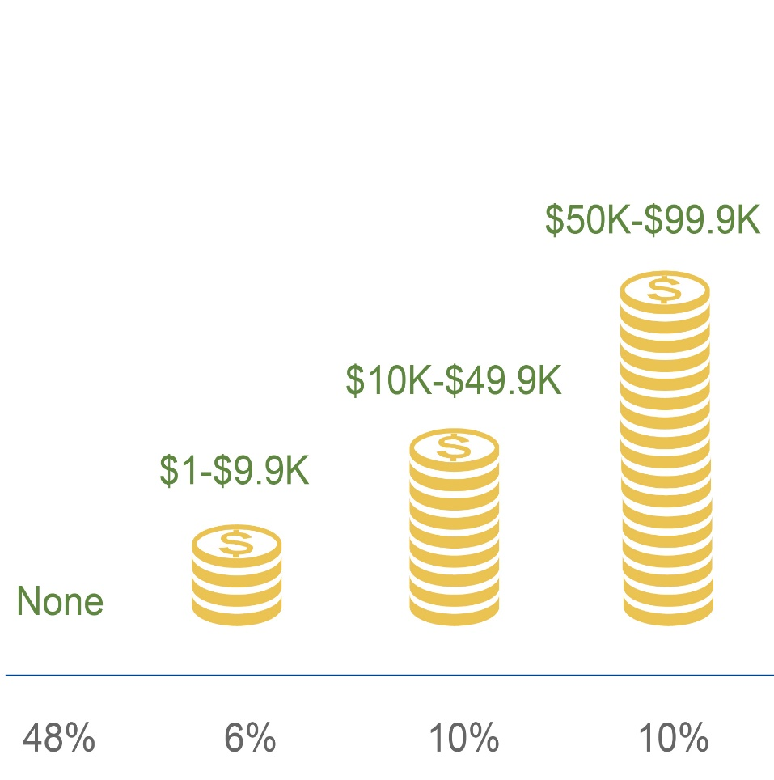
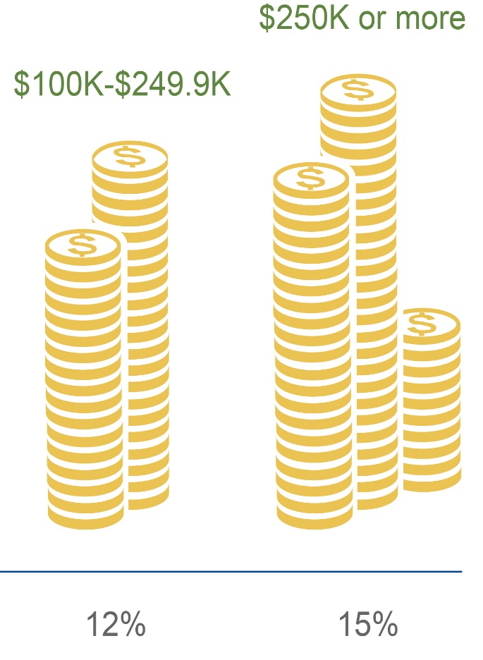
Because utilization is skewed, so too is the distribution of future expected costs
Source: Favreault & Dey (2015), Table 5 in Anne Tumlinson Innovations presented to SCAN Foundation, 2016. https://www.thescanfoundation.org/sites/default/files/financing_long-term_care_chartpack_092016_final.pptx

Slide 11
Current approaches to financing LTSS services
Primary Public approaches (Federal, state and local)
Medicaid
Public education about risks and costs to spur action
Primary Private Approaches (insurance and savings)
Current income, savings, annuitizing the home
Private long-term care insurance
Mixed Approaches (public trying to push private)
Partnership Programs between states and Federal government (45 states)
Federal and state tax incentives for LTC insurance purchase (30 states)
State employee LTC insurance programs (27 states)

Slide 12
The Medicaid program and families will pay most LTSS costs for elders with significant needs
Favreault and Dey (2015) Table 3.A. https://aspe.hhs.gov/basic-report/long-term-services-and-supports-older-americans-risks-and-financing-research-brief

Slide 13
Publicly Financed LTSS: Medicaid in U.S. and New York (2016)
Parameter | New York (thousands) | U.S. (thousands)
Total Medicaid | $60,421 | $549,308
Medicaid LTSS | $26,454¹ | $166,680
LTSS as a % of total Medicaid budget | 43.7% | 30.3%
Medicaid LTSS Institutional Care Home and Community-based Care | $9,865 (37%) $16,588 (63%) | $72,272 (43%) $94,407 (57%)
Growth in LTSS Expenditures (2013-2016) Institutional Care Home and Community-based Care | 16% -6% 33% | 14% 2% 26%
¹ Note that $10.6 billion is spent in managed LTSS in NY -- highest in U.S. and comprising 25% of total US expenditures in managed LTSS.
Source: Medicaid Expenditures for Long-Term Services and Supports in FY 2016, IBM Watson, May 2018, Table A and Table 65. https://www.medicaid.gov/medicaid/ltss/downloads/reports-and-evaluations/ltssexpenditures2016.pdf

Slide 14
Challenges with Medicaid financing
Obtaining eligibility through spend-down is threat to many individuals’ financial security.
Waiting lists and access limits for home and community-based care.
Less flexibility in service provision.
States struggling with budget pressures.
LTSS is approaching 30% to 45% of state Medicaid budgets and growing rapidly.
Reimbursement rates often do not support development of a high quality workforce and service infrastructure.

Slide 15
Can we rely on the Private Insurance Market to Solve the Problem?

Slide 16
Long-term care insurance
Two major categories of products (about 7-8 million people have coverage)
Stand-alone private LTC insurance sold in the individual and group markets.
Combination products: (1) Life and long-term care coverage combined; (2) Annuities and long-term care coverage combined.
Policies provide access to a “pool of benefits” when a threshold is reached and can be spent in a variety of settings – institutional and home & community-based
Most policies have level-funded premiums based on age at purchase.
Level premiums if actuarial assumptions underlying the policy are correct.
$227 monthly premium of policies sold in 2015 for a 60 year old

Slide 17
Current industry parameters (2017)
Parameters | U.S. Values | New York
Policies In-force (individual and group) | 6.8 million | 402,000
Earned Premiums | $11.7 billion | $1.02 billion
New Claim Reserves | $11.7 billion | $1.06 billion
Cumulative claims paid 1992-2012 Cumulative claims incurred 2013-2015 | $75.6 billion $29.6 billion | N.A.
Number filing new claims | 81,300 | N.A.
Number of In-force Claimants | 285,600 | N.A.
Average Claim Reserve | $107,000 | N.A.
Note: Number of inforce for life and annuity products with accelerated long-term care benefits is about .5 million.
Source: NAIC LTC Insurance Experience Reports for 2012 – 2017, LIMRA 2018.

Slide 18
Number of individual and group insured lives has been relatively flat since 2006 (thousands)
Source: NAIC LTC Experience Reports 1993-2018

Slide 19
Annual sales of stand-alone individual policies have been declining for close to 20 years
Note: LifePlans analysis based on AHIP, LIMRA and LifePlans sales surveys, 1990-2016. LIMRA data after 2016. Beginning in 2009, LTC Partners data for annuitants included in counts.

Slide 20
Combination products are growing in the market (thousands of policies in force)
Sources: NAIC Long-term care Experience Exhibit Reports, 2010-2018

Slide 21
The share of LTC individual policy sales to the middle market age 40-69 is declining
Preliminary data suggests combination product purchasers are also
drawn from upper income groups.
Note: Low income <33% of income distribution; Middle income = 33% - 66%; Higher income = >66%
Source: LifePlans analysis of AHIP Buyer Data, 2011 and 2015 and Social Security Administration, Income of the Population Age 55 and Over 2010 and 2014. https://www.ssa.gov/policy/docs/statcomps/income_pop55/2014/sect03.pdf
Notes:
21

Slide 22
Trends affecting profitability have been consistently negative
Since 2000, all major determinants of premium and product profitability have been going in the wrong direction:
interest rates are significantly lower than what was priced for,
voluntary lapse rates are lower than for any other insurance product,
morbidity is somewhat worse than expected and mortality is improving.
Prior decade saw a major exodus of companies from the market, as returns on the product have been significantly below expectation.
Only a dozen or so companies remain in market compared to over 100 in the year 2000.
Underwriting stringency excludes growing number of applicants – upwards of 30% of the target population. (https://www.healthaffairs.org/doi/full/10.1377/hlthaff.2015.1133)
Major rate increases have unnerved consumers.

Slide 23
Claims experience is deteriorating in recent years: Industry Actual to Expected Annual Incurred Claims, 2009-2017
Source: NAIC Experience Reports, 2009-2017

Slide 24
Why the private market is limited in its reach: Demand and Supply Issues
Demand: Consumer
Supply: Insurer
Product Cost
Lack of information/shrouded attributes
Misperceptions about need, costs, and coverage
Myopia
Consumer confusion/product complexity
Mistrust of industry/contracts
Adverse selection
High selling costs
Inefficient risk-bearing: common shocks outside carrier control
Uncertainty regarding regulatory approaches
Distribution challenges

Slide 25
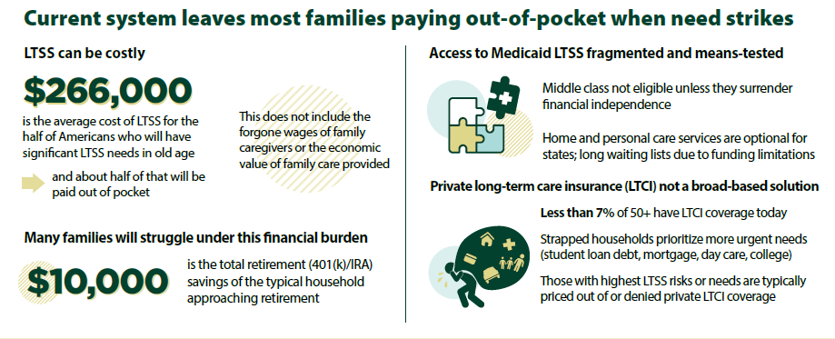
Where does this leave us?
Source: Veghte, Cohen, Tell and Bradley. “Designing a State-based Social Insurance Program for Long-Term Services and Supports. Washington DC. National Academy of Social Insurance. 2019.

Slide 26
Fundamental LTSS financing problem: Absence of an effective insurance mechanism
The distribution of risk makes LTSS perfectly suited to an insurance solution
Many people will have no need and a small number will be have catastrophic expenses
It is difficult to predict where you might fall in the distribution of risk
Even for the few who have the resources, savings does not make sense and it unreasonable.

Slide 27
Federal and State Initiatives in LTSS Financing

Slide 28
Current Federal Activity: Proposing Additions to Medicare Coverage
Pallone Bill: Catastrophic Protection plan with Medicare as a chassis
Sanders Medicare for All and also Dingell, Jayapal and more than 100 Co-Sponsors Introduce Medicare For All Act of 2019
Note: A number of think tanks advocacy groups supportive of catastrophic approach

Slide 29
Why are States interested in LTSS reform initiatives?
Limited growth in the private market fueling search for “shared or communal approaches”
Gridlock in policymaking at the federal level does not offer promise.
Changes in family composition lead to strains on budget, workforce & delivery system.
The costs of waiting are starting to exceed the costs of taking action

Slide 30
Do states have expertise to implement new LTSS insurance-based programs?
States are the only level of government with experience administering comprehensive LTSS.
More than 50 years defining and assessing benefit eligibility, certifying qualified providers, reimbursing providers, and managing benefits
Understand and familiar with the LTSS service delivery system.
States also have a solid track record in launching and running social insurance programs:
Workers’ compensation and unemployment insurance
Paid Family and Medical Leave (PFML) social insurance programs (4 states)
Greater political feasibility and ability to reflect unique needs of state residents.

Slide 31
States have started to take action
Hawaii
Tried but did not pass universal social insurance with 0.4% business excise tax
Kupuna Care – provides some LTSS at home to those age 60+ who exceed the Medicaid income-eligibility level
Kupuna Cargivers Program – working family caregivers get $210/week so they can purchase care for their loved one and thus stay in the workforce
Washington State
LTC Trust Act - the nation’s first public state-run LTSS program
Funded by employee-paid payroll tax of 0.58% with all workers contributing
Retirees or those not in the work force neither contribute nor benefit from program
Ten-year vesting period where workers pay into fund before they can claim benefits
$100/day paid for LTSS services up to lifetime maximum of $36,500
Benefit eligibility based on a combination of IADL, ADL and
cognitive deficits using state Medicaid program criteria.
Source: Tell and Cohen, 2010. https://www.questia.com/library/journal/1P4-2235646795/the-states-can-t-wait-the-long-term-care-financing

Slide 32
States have started to take action (2)
Maine
First state to put LTSS finance reform proposal to a ballot vote (Question 1) to create Maine’s Universal Home Care Program
The program to be funded by a 1.9% tax on individuals’ earned income over $127,500 with a similar contribution from employers.
Additional funding would come from a 3.8% tax on investment income about the Social Security tax cap, reduced by the payroll taxes paid.
Program defeated decisively – 67% (opposed) to 33% (favored).
California
California Aging and Disability Alliance pushing development of ballot initiative
The state budget allocates $3 million to support inclusion of LTSS questions on California Health Interview Survey
SB 512 creates LTC trust board asking $1 million for a feasibility study of a state-based LTSS financing program
Source: Tell and Cohen, 2010. https://www.questia.com/library/journal/1P4-2235646795/the-states-can-t-wait-the-long-term-care-financing

Slide 33
States have started to take action (3)
Michigan and Illinois
Exploring new options for those not qualifying for Medicaid
Feasibility study phase
State budgets include funds for actuarial analysis to explore LTSS financing options
Stakeholder groups pushing initiatives in both states
Minnesota
Exploring options for private LTSS financing vehicles for middle income market.
Convened an Advisory Panel of stakeholders to explore several new concepts.
Hired experts to support actuarial/market research to test product feasibility

Slide 34
What state initiatives have in common
Trying to move away from Medicaid-financed care toward insurance-financed care – to address middle class concerns
Those exploring public social insurance approaches typically prefer:
Universality
Contributory (“earned benefit”)
Limited benefit
Affordable
Fiscally sustainable and self-funded
Room for private insurance market role

Slide 35
Key Program Considerations when considering a state-based LTSS financing approach
Eligible Populations
Program Design
Financing Approach
Implementation & Integration
Source: ET Consulting, 2019.

Slide 36
Eligible population and program design
Eligible Population
Generational Transition Issues
Timing and Duration of Coverage
First dollar (front-end coverage)
Catastrophic Coverage (back-end)
Comprehensive coverage
Benefit eligibility criteria
Level of benefit payment
Form of benefit (cash or service reimbursement)

Slide 37
Financing sources and considerations
Potential Sources
Existing Federal Social Insurance Programs
Social Security
Medicare Part A
Medicare Parts B and D
Medicare net investment income tax
Existing State Social Insurance Programs
Workers compensation
Unemployment insurance
Paid family and medical leave
Additional Potential Funding Approaches
Taxes
Fees
Premiums
Considerations
Pay As You Go vs. Pre-Funding
Size of tax base
Fiscal sustainability
Political sustainability
Affordability
Connection w/program benefits
More than one funding source

Slide 38
Examples of estimated tax rates for alternative program configurations
Policy Option | Income Tax | Medicare Tax | Social Security Tax
Catastrophic Protection Benefit Plan (2 to 4 year waiting period) | 0.57% | 0.58% | 0.74%
Washington Front-End plan | 0.58% | 0.59% | 0.75%
Home Care $36,500 | 0.83% | 0.85% | 1.08%
Home Care $73,000 | 1.33% | 1.37% | 1.73%
Home Care Unlimited | 3.12% | 3.19% | 4.03%
Source: Veghte, Cohen, Tell and Bradley. “Designing a State-based Social Insurance Program for Long-Term Services and Supports. Washington DC. National Academy of Social Insurance. 2019.

Slide 39
Tax rates converted to 2018 premiums for alternative program configurations for typical person
Policy Option | Annual Premium | Monthly Premium
Catastrophic Protection Benefit Plan (2 to 4 year waiting period) | $350 | $29
Washington Front-End | $360 | $30
Home Care $36,500 | $515 | $43
Home Care $73,000 | $820 | $68
Home Care Unlimited | $1,920 | $160
Source: Veghte, Cohen, Tell and Bradley. “Designing a State-based Social Insurance Program for Long-Term Services and Supports. Washington DC. National Academy of Social Insurance. 2019.

Slide 40
Integration Issues: Payment & Delivery System
Coordination of benefits with other payers
Who is second payer?
Coordination of benefits with private insurance
Federal Medicaid Funding Issues
How to assure no loss of Federal Matching
Are program benefits considered income?
Integration of LTSS and Medical Care
How to integrate with coordinated delivery systems?
How to build on innovation occurring at service delivery level?

Slide 41
To what end?
Improving access to LTSS. To what extent does the additional money brought into the LTSS system by the program allow the purchase of additional services?
Reducing family out-of-pocket spending. To what extent does the program relieve financial burdens on families?
Reducing Medicaid spending. To what extent does the program reduce budgetary pressure on Medicaid?
Financial sustainability/stability. Is the program sustainable? Can it to be paid for over the long term in a stable manner?
Political support and sustainability. Is the program structured in a manner that will garner broad public support that is likely to persist over time?

Slide 42
Contact Information
Marc A. Cohen, Ph.D.
Clinical Professor, Department of Gerontology, McCormack Graduate School Co-director, LeadingAge LTSS Center @UMass Boston Research Director, Center for Consumer Engagement and Health System Transformation, Community Catalyst
Contact
Phone: 617.287.7306
Email: Marc.Cohen@umb.edu

