Slide 1
Candida auris in New York State:
Infection Prevention and Control for Environmental Services
NYSDOH
July 2017

Slide 2
Outline
Background
Candida auris
NYSDOH activities to help control Candida auris
Infection Prevention and Control
Cleaning and Disinfection
Hand Hygiene
Standard and Contact Precautions

Slide 3
Background

Slide 4
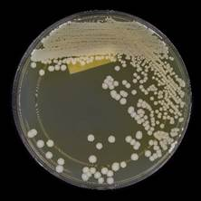
What is Candida auris? (also called C. auris)
A fungus (yeast) that infects people who are sick for other reasons
Often infects blood
Can live on skin even after patients recover
Some people have it on their skin but don’t get sick (they are “colonized”)
Not the same as the yeast that causes diaper rash, “yeast infections” in women, and “thrush” in the mouth

Slide 5
Why Are We Worried?
It is hard for laboratories to identify
Anti-fungal medicines might not work against it
It spreads within hospitals, nursing homes, and other healthcare facilities
It can live for many weeks on surfaces and equipment

Slide 6
Rapid Emergence Since 2009
Pakistan
Venezuela
Israel
United Kingdom
S. Africa
Kenya
Kuwait
Japan
South Korea
India
2009 2010 2011 2012 2013 2014 2015 2016
Candida auris is now found in multiple states in the U.S., including New York.
Notes:
Candida auris has now been identified in people in the United States.

Slide 7
What Is New York State Doing?
Investigating reports of C. auris
Testing samples from patients and their surroundings at the New York State Public Health Laboratory, Wadsworth Center.
Teaching healthcare staff how to prevent and control C. auris infection and spread
Going to all hospitals and nursing homes in Brooklyn and Queens to help them prevent spread
Notes:
The New York State Department of Health is currently actively involved in investigating and responding to suspected and confirmed cases of Candida auris. Activities include investigating reports by reviewing medical records, identifying and tracking healthcare facilities where cases have been recently and in some cases, test people and surfaces for C. auris when we suspect there may be spread. NYSDOH is also educating healthcare facilities and healthcare providers about C. auris and how to prevent and control the spread within healthcare settings.

Slide 8
Infection Prevention and Control in the Healthcare Environment

Slide 9
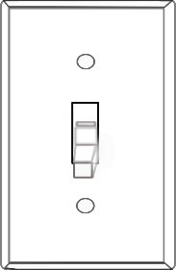
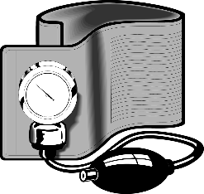
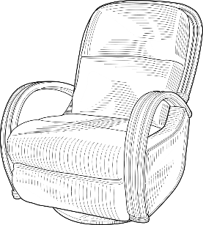
Why Is Infection Control Important for Candida auris?
Notes:
Like other antibiotic-resistant organisms, Candida auris can stay in the healthcare environment for long periods of time. It is also present on the skin of patients or residents and can be easily shed into the surrounding environment. When we don’t clean and disinfect properly, C. auris might spread to other patients or residents.
In other countries, the healthcare environment has played a significant role in outbreaks of C. auris.

Slide 10
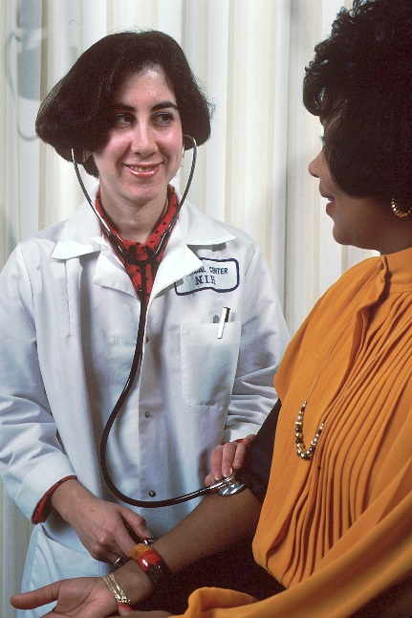
Are Healthcare Workers At Risk?
C. auris does not typically cause infections in healthy people
Anyone can be colonized on the skin, but this doesn’t happen very often for healthcare workers
https://www.cdc.gov/fungal/diseases/candidiasis/qa-healthcare-workers.html Accessed 6/8/2017
Notes:
Image from National Cancer Institute Visuals Online. https://visualsonline.cancer.gov/details.cfm?imageid=2392

Slide 11
Protect Patients by:
Cleaning and disinfecting thoroughly and correctly
Cleaning your hands
Using gowns and gloves correctly whenever they are needed

Slide 12
Cleaning and Disinfection
Patient Zone
Closest to or touching the patient and is the most contaminated
Healthcare Zone
Farther from the patient, but possibly contaminated
Notes:
The patient zone includes the equipment and furniture closest to or touching the patient or resident. This is the most contaminated area of a patient room or cubicle. The healthcare zone includes equipment and surfaces that healthcare workers may touch when providing care to the patient or resident. This may include high touch surfaces that need greater emphasis when cleaning.
APIC Chapter: Chou T. APIC Text Online: Environmental Services Chapter. http://text.apic.org/. Published 10/3/2014. Accessed 6/9/2017.

Slide 13
Cleaning and Disinfection
Use the same product you use for Clostridium difficile
Be sure you know:
How long is the contact time?
Do I need to re-wet to get the correct contact time?
Does it need to dry or should I wipe it off?

Slide 14
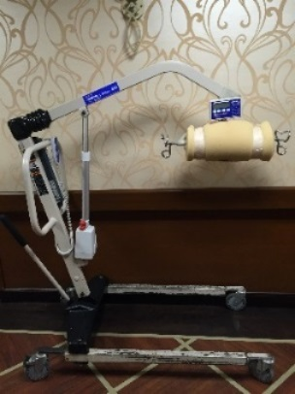
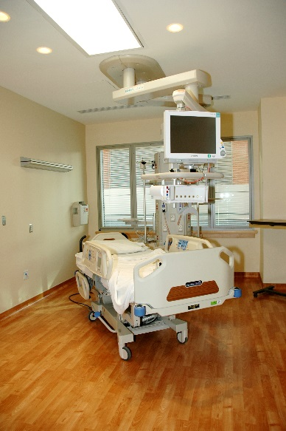
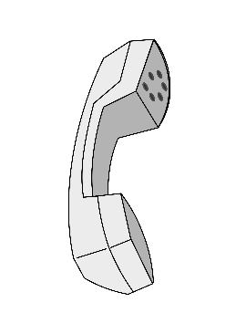
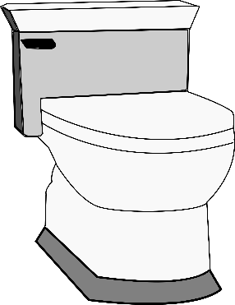
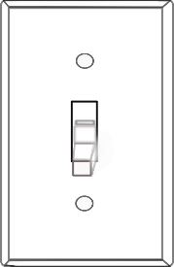
Cleaning and Disinfection
High touch surfaces need more frequent cleaning
Always follow your facility-specific policy!
Source: https://www.cdc.gov/hicpac/pdf/isolation/Isolation2007.pdf
Notes:
C. auris has been found on high touch surfaces in hospitals and nursing homes, both in patient rooms and spread through the unit.
Special attention should be paid to cleaning high touch surfaces and surfaces in close proximity to the patient or resident.
Facility should review their cleaning processes and policy for cleaning high touch surfaces.

Slide 15
Cleaning and Disinfection
Clean from least dirty to most dirty
Do not re-wet a dirty cloth
Keep dirty cloths separate from clean cloths
Make sure to clean the cleaning cart and equipment, too
Example: mop handles and spray bottles
Always follow your facility-specific policy!

Slide 16
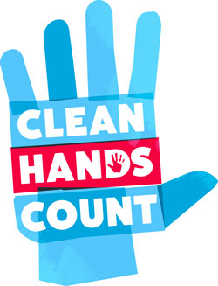
Hand Hygiene - Why?
Hands are the most common way germs are spread in healthcare
C. auris can live on surfaces and objects
Can be picked up on hands and shared
Gloves are not a substitute for hand hygiene
Always follow your facility-specific policy!
Source: https://www.cdc.gov/handhygiene/providers/guideline.html (including image)

Slide 17
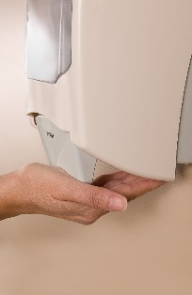
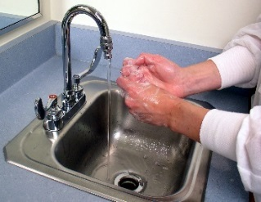
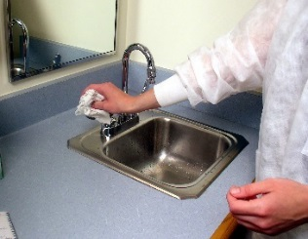
Hand Hygiene - Wash or Sanitize?
OR
Always follow your facility-specific policy!
Source: https://www.cdc.gov/handhygiene/providers/guideline.html
Notes:
Images from CDC PHIL
It’s important to know when to use soap and water and when it is ok to use alcohol-based hand sanitizer (gel or foam).
Wash with soap and water when:
Hands are visibly dirty
Caring for a person with C. difficile or infectious diarrhea during norovirus outbreaks
Before eating
After using the restroom
Otherwise, use alcohol-based hand sanitizer

Slide 18
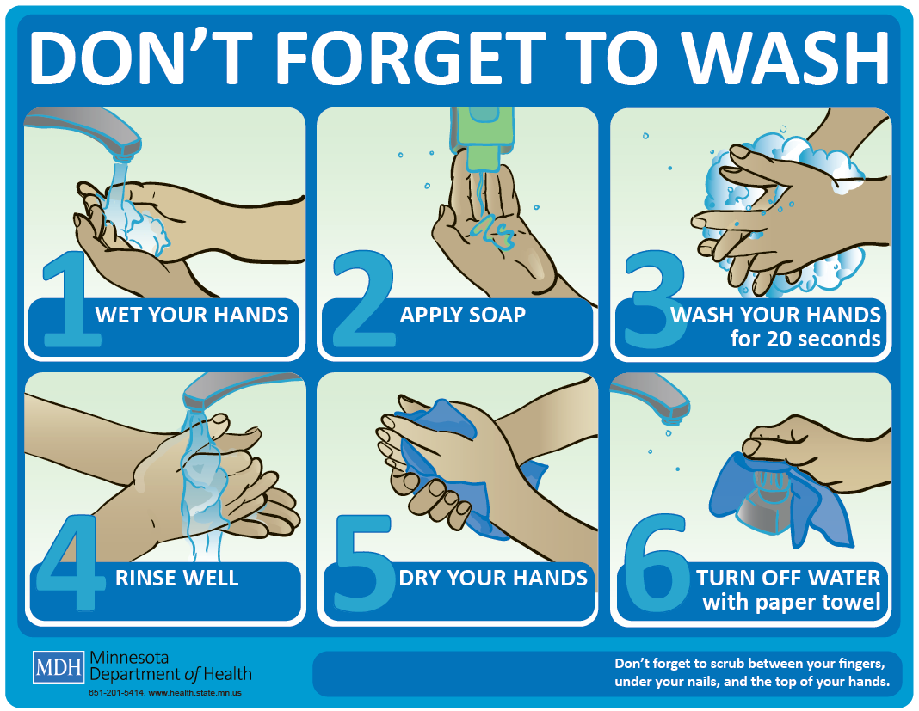
Hand Hygiene – Soap and Water
Use when you can see your hands are dirty
After using the restroom
Before you eat
Any other times your facility policy says to
Always follow your facility-specific policy!
Source: https://www.cdc.gov/handhygiene/providers/guideline.html
Notes:
Wash your hands with soap and water when you can see they are dirty, after you use the restroom, and before you eat. Facility policy
Follow the steps in the diagram:
Make sure to wash for 15-20 seconds (or per your facility policy)
Steps for aoap and water wash:
Wet hands with water and apply soap
Rub hands vigorously for 15-20 seconds
Make sure to clean your whole hand, including nails
Rinse with water
Dry hands completely with a disposable towel
Use a paper towel to turn off faucet

Slide 19
Hand Hygiene – Sanitize
Use any time other than when you must wash with soap
Cover your whole hand and nails with the sanitizer
Rub hands until they dry
Always follow your facility-specific policy!
Source: https://www.cdc.gov/handhygiene/providers/guideline.html
Notes:
For example, you may use alcohol rub/gel when you change gloves during cleaning
Image from CDC PHIL

Slide 20
Hand Hygiene – Fingernails, too
Keep fingernails short and clean
Best to avoid artificial nails
Includes gels, wraps, extensions, nail jewelry, etc.
Bacteria, viruses, and fungi can stick to material used to make artificial nails
Always follow your facility-specific policy!
Source: https://www.cdc.gov/mmwr/PDF/rr/rr5116.pdf

Slide 21
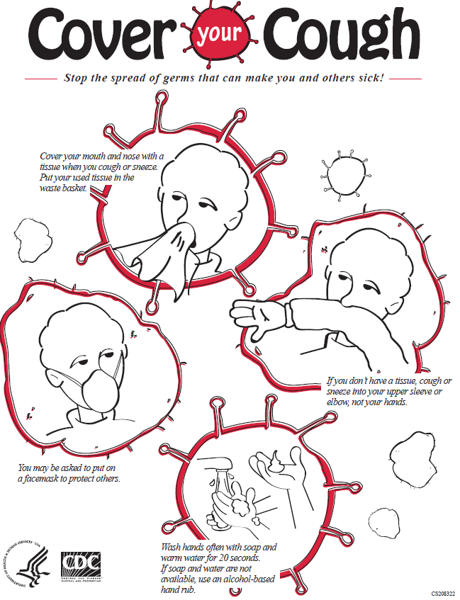
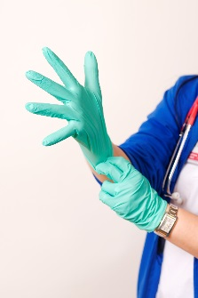
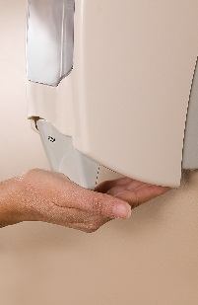
Standard Precautions
Every patient and resident, every day
respiratory hygiene/cough etiquette
safe injection practices
hand hygiene
personal protective equipment based on your task
Always follow your facility-specific policy!
Source: https://www.cdc.gov/hicpac/pdf/isolation/Isolation2007.pdf

Slide 22
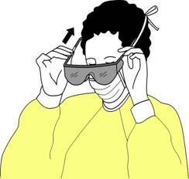
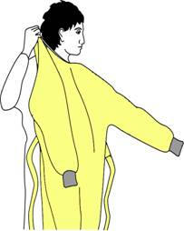
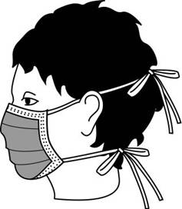
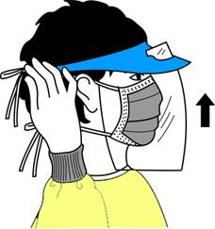
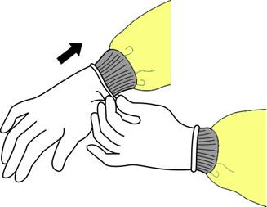
Personal Protective Equipment (PPE)
Always follow your facility-specific policy!
Notes:
Images from: https://www.cdc.gov/hai/prevent/ppe.html. Slide set: Guidance for the Selection and Use of Personal Protective Equipment in Healthcare Settings
Presenters should review the facility specific use of PPE for Environmental Services staff during routine cleaning and when the patient or resident is on contact precautions.
Review when gloves should be changed during the cleaning process, including hand hygiene between glove changes

Slide 23
Contact Precautions
Used to stop the spread of C. auris
Gloves and gowns put a barrier between you and the patient and surfaces around the patient
If you are unsure – ask before entering!
Always follow your facility-specific policy!
Source: https://www.cdc.gov/hicpac/pdf/isolation/Isolation2007.pdf
Notes:
Contact precautions are used in addition to Standard Precautions and should apply each time you care for a patient with an organisms that can be spread or moved by touching

Slide 24
Personal Protective Equipment (PPE) Pop Quiz!
Where do we store gloves, gowns and eye protection or face masks?
If it runs out, where do I find more?
Where should I put PPE on?
Is PPE allowed in the hallways?
For example: when getting a new cloth during cleaning?
Where should I take PPE off?
Always follow your facility-specific policy!

Slide 25
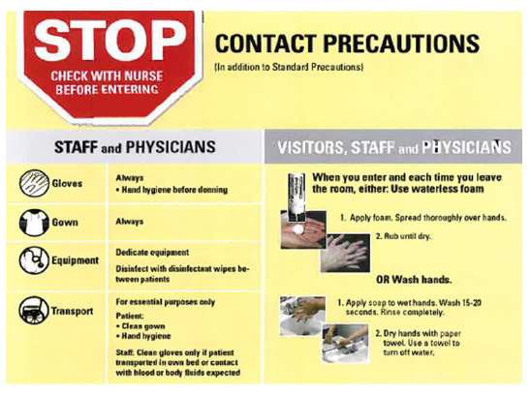
Communication
Know your facility signs!
See Nurse before entering
Contact Precautions
Gown and Gloves needed to enter
Always follow your facility-specific policy!
Source: https://www.cdc.gov/hicpac/pdf/isolation/Isolation2007.pdf
Notes:
Use this slide to review your facility specific signs for transmission based precautions. Review any conventions for communicating that Contact Precautions are needed.
Use this slide to discuss facility-specific policies and practices used to communicate infection control related information.
Discussion points:
How do I know when I need to use Contact Precautions?
How do I know when I need to do a terminal clean and what type of terminal clean (regular, C. difficile/C. auris, other Contact Precautions, etc.)?
Sign example: https://www.mnhospitals.org/Portals/0/Documents/ptsafety/CDICleaning/4.%20Environmental%20Services%20Cleaning%20Guidebook.pdf

Slide 26
Summary
Infection prevention and control activities are shared responsibilities in healthcare
Help prevent C. auris spread in healthcare settings by:
Performing hand hygiene
Using Standard and Contact precautions
Cleaning and disinfecting surfaces and equipment in healthcare settings thoroughly and correctly
Notes:
Thank you
Multidrug-resistant organisms are common. Healthcare workers should perform hand hygiene and use Standard and Contact Precautions correctly. Healthcare workers should also know how to correctly clean and disinfect healthcare surfaces, including equipment used to care for patients and residents.
It is expected that healthcare facilities, including nursing homes and dialysis facilities, maintain the capacity to manage infection control for patients or residents infected or colonized with C. auris or any MDRO.

Slide 27
References
Borman AM, Szekely A, Johnson EM. Comparative pathogenicity of United Kingdom isolates of the emerging pathogen Candida auris and other key pathogenic Candida species. mSphere. 2016;1:e00189–16.
Calvo B, Melo ASA, Perozo-Mena A, et al. First report of Candida auris in America: clinical and microbiological aspects of 18 episodes of candidemia. J Infect. 2016;73:369–74.
Chakrabarti A, Sood P, Rudramurthy SM, et al. Incidence, characteristics and outcome of ICU-acquired candidemia in India. Intensive Care Med. 2015;41:285–95.
Chowdhary A, Kumar VA, Sharma C, et al. Multidrug-resistant endemic clonal strain of Candida auris in India. Eur J Clin Microbiol Infect Dis. 2014;33:919–26.
Chowdhary A, Sharma C, Duggal S, et al. New clonal strain of Candida auris, Delhi, India. Emerg Infect Dis. 2013;19:1670–3.
Chowdhary A, Voss A, Meis JF. Multidrug-resistant Candida auris: ‘new kid on the block’ in hospital-associated infections? J Hosp Infect. 2016;94:209–12.
Emara M, Ahmad S, Khan Z, et al. Candida auris candidemia in Kuwait, 2014. Emerg Infect Dis. 2015;21:1091–2.
Kathuria S, Singh PK, Sharma C, et al. Multidrug-resistant Candida auris misidentified as Candida haemulonii: characterization by matrix-assisted laser desorption ionization-time of flight mass spectrometry and DNA sequencing and its antifungal susceptibility profile variability by Vitek 2, CLSI broth microdilution, and Etest method. J Clin Microbiol. 2015;53:1823–30.
Kim M-N, Shin JH, Sung H, et al. Candida haemulonii and closely related species at 5 university hospitals in Korea: identification, antifungal susceptibility, and clinical features. Clin Infect Dis. 2009;48:e57–61.
Lee WG, Shin JH, Uh Y, et al. First three reported cases of nosocomial fungemia caused by Candida auris. J Clin Microbiol. 2011;49:3139–42.
Lockhart SR, Etienne KA, Vallabhaneni S, et al. Simultaneous emergence of multidrug resistant Candida auris on three continents confirmed by whole genome sequencing and epidemiological analyses. Clin Infect Dis. Advance access, published October 20, 2016, accessed December 15, 2016.
Magobo RE, Corcoran C, Seetharam S, et al. Candida auris-associated candidemia, South Africa. Emerg Infect Dis. 2014;20:1250–1.
Oh BJ, Shin JH, Kim M-N, et al. Biofilm formation and genotyping of Candida haemulonii, Candida pseudohaemulonii, and a proposed new species (Candida auris) isolates from Korea. Med Mycol. 2011;49:98–102.
Okinda N, Kagotho E, Castanheira M ,et al. Candidemia at a referral hospital in sub-Saharan Africa: emergence of Candida auris as a major pathogen. European Congress of Clinical Microbiology and Infectious Diseases. Barcelona, 2014. Poster presentation.
Sarma S, Kumar N, Sharma S, et al. Candidemia caused by amphotericin B and fluconazole resistant Candida auris. Indian J Microbiol. 2013;31:90–1.
Satoh K, Makimura K, Hasumi Y, et al. Candida auris sp. nov., a novel ascomycetous yeast isolated from the external ear canal of an inpatient in a Japanese hospital. Microbiol Immunol. 2009;53:41–4.
Schelenz S, Hagan F, Rhodes JL, et al. First hospital outbreak of the globally emerging Candida auris in a European hospital. Antimicrob Resist Infect Control. 2016;5:eCollection.
Centers for Disease Control and Prevention. Recommendations for Infection Control for Candida auris. Available at: https://www.cdc.gov/fungal/diseases/candidiasis/c-auris-infection-control.html (Accessed 7/24/2017)
Siegel JD, Rhinehart E, Jackson M, Chiarello L, and the Healthcare Infection Control Practices Advisory Committee, 2007 Guideline for Isolation Precautions: Preventing Transmission of Infectious Agents in Healthcare Settings. https://www.cdc.gov/hicpac/pdf/isolation/isolation2007.pdf
Images from the Centers for Disease Control and Prevention, Public Health Image Library. https://phil.cdc.gov/phil/quicksearch.asp
Centers for Disease Control and Prevention Guideline for Hand Hygiene in Health-Care Settings: Recommendations of the Healthcare Infection Control Practices Advisory Committee and the HICPAC/SHEA/APIC/IDSA Hand Hygiene Task Force. MMWR 2002;51 (No RR-16). https://www.cdc.gov/mmwr/PDF/rr/rr5116.pdf
Centers for Disease Control and Prevention Infection Prevention in Dialysis Settings Continuing Education Module. Available at: https://www.cdc.gov/dialysis/clinician/ce/infection-prevent-outpatient-hemo.html
Chou T. APIC Text Online: Environmental Services Chapter. http://text.apic.org/. Published 10/3/2014. Accessed 6/9/2017

Slide 28
Additional Material
Additional material is included here to assist presenters. These materials include a pre/post-test and vignettes from observations made by the NYSDOH during site visits.

Slide 29
Pre-test and Post-test
What is Candida auris?
List two reasons why Candida auris is of concern
What cleaning product should be used for Candida auris?
How long is the contact time for that product?
Identify the times when hand hygiene must be performed.
Identify how your facility communicates when to use contact or droplet precautions.

Slide 30
Infection Control Breach Observations
Environmental Cleaning
Ventilator screens have been observed to either not be cleaned while in routine use or not cleaned with a sporicidal agent. NYSDOH has identified C. auris from ventilators after the equipment had reportedly been terminally cleaned.
Shared equipment such as mechanical patient lifts are not cleaned with sporicidal agent.
Cleaning and disinfection was performed using a spray bottle. The cleaning agent was sprayed on and then immediately wiped off, so did not stay on the surface for the appropriate contact time.
Cleaning products that are not intended or registered for use in a healthcare environment have been observed in healthcare facilities.
The products in use are not effective against the organisms in the environment. For example, cleaning products available for cleaning and disinfection when a patient has C. difficile or C. auris were not EPA registered as effective against spores.
Notes:
C. auris can survive for extended periods of time on surfaces in healthcare settings. Care must be taken to clean using the correct product (a product registered with the Environmental Protection Agency (EPA) as a sporicidal agent) according to the manufacturers instructions for use for cleaning and disinfecting. These are examples to highlight break downs in environmental cleaning and disinfection processes.

Slide 31
Infection Control Breach Observations
Contact Precautions and PPE
Multiple disciplines of healthcare workers, including frontline staff, nursing leadership (Director of Nursing), and physicians have been observed entering rooms without PPE and without having performed hand hygiene.
PPE is not worn correctly. Observations include healthcare workers with gowns untied and hanging off the neck. Inappropriate gowns for healthcare have been observed, including apron-type gowns with no sleeves to protect arms.
PPE has been unavailable to staff for use with Standard and Contact precautions. For example, PPE was stored in a locked cabinet down the hall and facility could not locate the key. PPE needed to care for a resident on Contact Precautions has been observed stored in a clean linen cart down the hall.
Staff interview identified that staff did not understand that PPE is still needed when Contact Precautions are in place after a room had just been cleaned.
Color-coded signs were in use to indicate Transmission-Based Precautions, including Contact Precautions, but frontline staff couldn’t recall what the colors meant.
Notes:
PPE use might seem straightforward, but often used incorrectly, details of donning/doffing important competencies. The examples here are to provide examples of breaches in infection control practices.

