Slide 1
Know Your Vehicle: Basic Operation, Starting Procedures, Stopping, & Steering

Slide 2
Session Goals
Demonstrate familiarity with the location and navigation of owner’s manuals regarding functions and operations of instruments in the vehicle.
Learn and demonstrate the importance of legal and safe starting, stopping and turning maneuvers.
Demonstrate and explain the importance of appropriate driving space and following distance to help ensure safe driving in all conditions.

Slide 3
Key Vocabulary and Topics
Accelerator pedal
Air bags
Area around the vehicle
Body position
Brake pedal
Cruise/speed control
Cover brake
Enhanced mirror settings
Gear selector lever
Hazard flasher
Owner’s manual
Parking brake
Pre-drive procedures
Pre-entry checks
Temperature controls
Odometer
Fuel gauge
Speedometer
Occupant restraints
Passive/active restraints
Head rest
Turn signals
Trunk release

Slide 4
Key Vocabulary and Topics cont.
Fuel cap release
Visual reference point
Windshield wipers and washers
Hazards/emergency flashers
Head restraint
Headlights (high and low beams)
Hood release
Ignition switch
Instrument panel
Key fob
Mirrors/mirror settings
Operating vehicles control devices
Creep vs Inch vs Roll
Blind spots and reference points
SMOG - Signal, Mirror, Over the Shoulder, Go
Safety, communication, comfort and convenience devices
Dashboard icons and symbols
Air condition control
Air vents
Back up lights
Intermittent wipers
4 L’s of Exiting: Look, Lever, Look, Leave

Slide 5
Key Information from Owner’s Manual
Initial vehicle set up
How to check vehicle fluids
Tips for better driving practices (Optimizing gas mileage)
How to troubleshoot common problems
How to clean vehicle surfaces
Vehicle specifications (tire size, oil type)
What does this “button” do?
Dashboard light recognition
What the warranty covers

Slide 6
Recognizing Symbols and Dashboard Warning Lights
Though dashboard warning lights vary from vehicle to vehicle, some common warning symbols and controls are pictured on the following slides.
Why is it important to recognize dashboard warning lights?

Slide 7






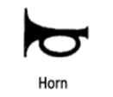
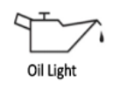
Recognizing Symbols and Warning Lights

Slide 8
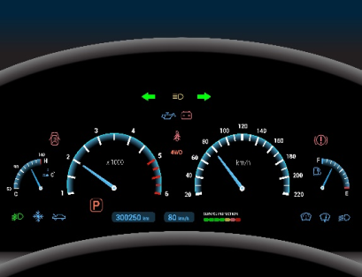
Warning Light Recognition Activity
Explain the importance of the following warning lights
  Engine temperature
  Oil pressure
  Battery charging light
  Brake warning light
  Check engine light

Slide 9
Developing Good Driving Habits
Good driving habits, including adequate preparation, are essential to safely and efficiently operating a vehicle.
What might you do to prepare yourself, your vehicle, and your passengers before driving?
What potential consequences could result if the driver, vehicle, or passengers are not prepared to drive?

Slide 10
Pre-Driving Check Activity
Working in pairs, draft a pre-drive checklist
  Checklists should cover preparation for both the vehicle and the driver
  Be prepared to discuss pre-drive checklists as a group

Slide 11
As You Approach Your Vehicle
Name some actions you can perform that will keep you safe before you even get in the vehicle.
What might you check on the outside of your vehicle?

Slide 12
Before You Start to Drive
Let’s brainstorm and list some things we need to do before putting the car in drive.

Slide 13
Adjusting the Vehicle
What adjustments can be made to better match the fit between you and your vehicle?
  Seat position/head restraint
  Steering wheel
  Mirrors
  Seat belt

Slide 14
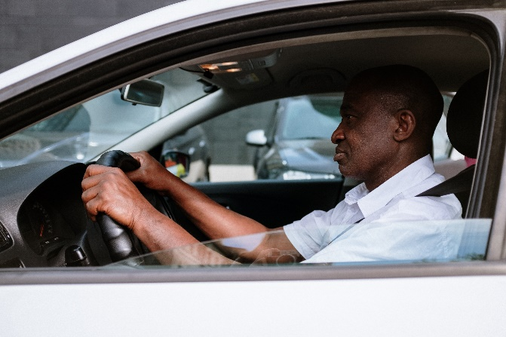
Body Position
How should the driver’s body be positioned, relative to the vehicle controls? Indicate if the following statement is true or false
Have good posture and sit up straight in the seat.
Your legs should comfortably reach all the pedals. Don’t drive cramped…and certainly don’t sit so far away from the pedals that you have stretch to reach them.
Your arms should be outreached to the steering wheel with a slight bend—not locked straight, nor too cramped. 10-12 inches is about right.
T
T
T

Slide 15

Adjusting the Head Restraint
Adjust the top of the head restraint so it is level with the top of your head. This will protect you from whiplash injury should you crash.
See How to Save Your Neck in
a Rear-End Crash
Consumer reports

Slide 16
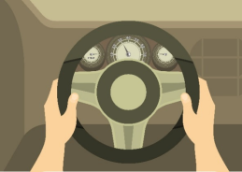
Steering Wheel-Hand Position
Hand position-check for thumb tabs
Check for ability to reach
secondary controls and pedals

Slide 17
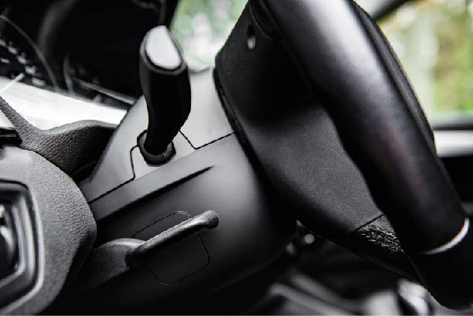
Adjusting the Steering Wheel/Column
Some cars even allow for the steering wheel to push into or away from the dash (telescopic). Consult your owner’s manual for this adjustment.

Slide 18
Adjusting the Seat Belts
Using your seat belt is the single most effective way to protect yourself in the event of a crash.
The lap belt and shoulder belt should be secured across the pelvis and rib cage, which is better able to withstand crash forces than other parts of the body.
Place the shoulder belt across the middle of the chest and away from the neck.
The lap belt should rest across the hips, not the stomach.
NEVER put the shoulder belt behind the back or under the arm.

Slide 19
Seat Belt Height Adjustment
The shoulder harness can be adjusted for better fit by adjusting the anchor height above the driver’s left shoulder.
Check your owner’s manual for further information

Slide 20
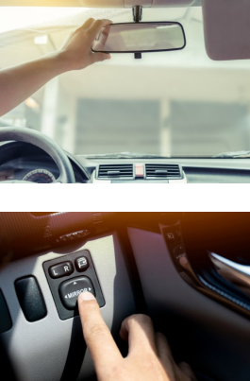
Mirror Settings
It is important know how to adjust your mirrors, what can and can’t be seen in them, where your blind spots are.
Let’s review different strategies for setting your mirrors as well as the associated advantages and disadvantages.
Strategies for Setting Your Mirrors
Oregon Driver Risk Prevention Curriculum Playbook. Oregon Department of Transportation

Slide 21

Adjusting Rearview Mirror
Adjust the rearview mirror so you can see out the entire rear window.
Do not move your head to see the mirror, but instead just glance between the front window and the rearview mirror.

Slide 22
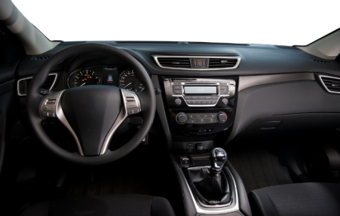
Know Where Important Controls are Located
Door locks
Window controls
Mirror adjustments
Windshield wipers
Headlights
Emergency hazards
Hood release
Trunk release
Fuel door release

Slide 23
Starting the Engine
Check the gear shifter to ensure it is in (P)Park or (N)Neutral
Place your foot on the brake pedal
Turn the ignition key or press the Start button
Stop turning the key/pressing the Start button as soon as the engine starts
Check all your gauges to makes sure there are no warning lights
Turn on your day-time running lights/low beam headlights
With foot still on brake, shift the car into (D)Drive. When you release the brake, the car will move (idling).

Slide 24
Steering Techniques
Three steering techniques:
  Hand-over-hand steering
  Hand-to-hand steering
  One-hand steering
Keep your thumbs poised on the outside of the wheel rather than a full, tight grip. Just relax.

Slide 25
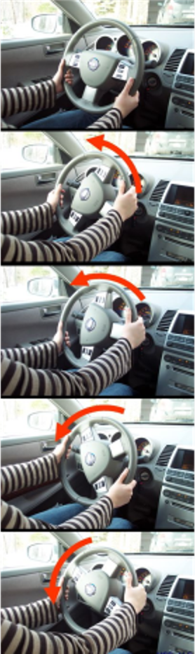
Hand-Over-Hand Steering
Grasp the steering wheel with your right hand at 3 o’clock and your left hand at 9 o’clock
Use the opposite hand of the turning direction to start the turn
One hand pushes the steering wheel up, past the 12 o’clock position, while the other hand reaches up to the 12 o’clock position, and pulls down towards 9 or 3 o’clock rotating the wheel in this fashion for the degree of turning needed.
Hence called “hand-over-hand”, H-O-H technique.
Used with permission from National Highway Traffic Safety Association. Using Efficient Steering Techniques.

Slide 26

Hand-to-Hand Steering
This is another steering method that may be used for making turns
Starting at the 9 & 3 position on the wheel, one hand pushes up on the steering wheel to the 12 o’clock position while the other hand slides to the top and then pulls the wheel down, repeating the action until the turn is complete
This is something called “feeding” the wheel or “H-T-H” hand to hand steering technique. Both hands are always employed in the steering and wrists never cross.
Try testing both H-O-H or H-T-H to see which technique works best for you
Used with permission from National Highway Traffic Safety Association. Using Efficient Steering Techniques.

Slide 27
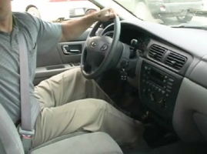
One-Handed Steering
Why isn’t One-Handed Steering recommended to use when driving?
One-handed steering is only recommended when you are backing up.
Steering with just your palm on the wheel is dangerous as you hand may slip from the wheel.
Used with permission from National Highway Traffic Safety Association. Using Efficient Steering Techniques.

Slide 28
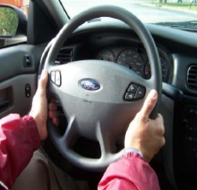
Steering Wheel Grip
There is no need for a death grip on your steering wheel. Comfortably, grip your steering wheel at the 9 & 3 position, or the 8 & 4 position. Do what is more comfortable for you, the driver.
A tense driver is not a safe driver. Be relaxed – don’t lock your elbows, but instead have a slight bend in your outreached arms.
Used with permission from National Highway Traffic Safety Association. Using Efficient Steering Techniques.

Slide 29
Steering Errors
A substantial percentage of crashes involving 16-year old drivers result from failure to make improper evasive steering.
Of the three controls a driver has when driving after, (accelerating, braking and steering) steering is the “primary function”.
What steering errors could drivers commit?
What could be the results of such errors?

Slide 30
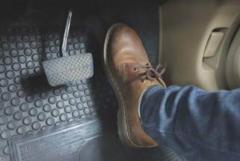
Operating Foot Pedals
Tips for operating the accelerator and brake pedals smoothly:
Wear good shoes (No flip flops!)
Rest the heel of your right foot on the floor in front of the brake pedal
Pivot on your heel, so that your foot alternates between the accelerator and brake
Make sure you can press the brake fully without toes slipping off the pedals

Slide 31
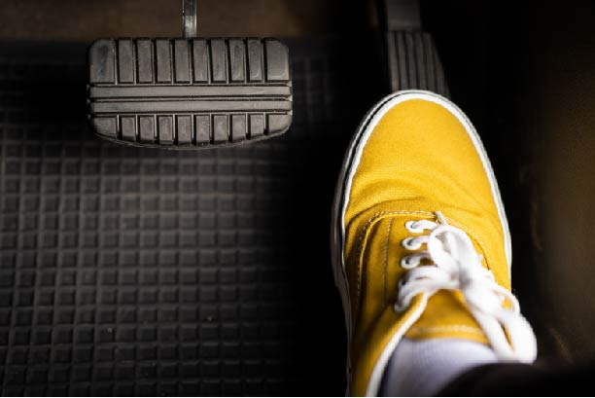
Accelerating the Vehicle
Accelerating the vehicle takes practice as there are a range of accelerations that you’ll need to master to be a great driver.

Slide 32
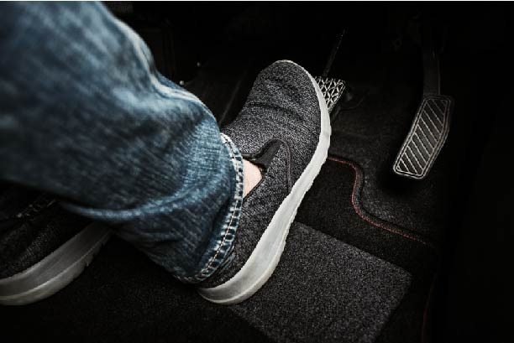
Braking and Decelerating
Like acceleration, braking requires practice to perform smooth and precise braking.

Slide 33
Occupant Protection-Vehicle Integrity
How do these safety features help protect you?
  Seat belts – shoulder belt and lap belt
  Head restraints – adjustable vs stationary
  Air bags – side and frontal protection, other types
  Collapsible steering column and padded cash
  Driver compartment crumble zones

Slide 34
Communication and Visibility Features
These are considered secondary controls:
Horn
Turn Signals
Hazard flashers
Windshield wipers and washers
Headlights
Can you list any others?

Slide 35
Tips on Using the Primary and Secondary Controls
Gear selector – Don’t get ahead of yourself – always check which gear you are in
Accelerator pedal – Understand that once you reach cruising speed light pressure is only needed to maintain speed
Brake pedal – Braking is used to slow down the vehicle, but the driver’s foot should not rest on the pedal; This gives off false messages to following drivers by way of activating the brake lights.
Clutch pedal – In manual shift vehicle the driver must use this to switch gears and hold the vehicle on a hill. Don’t stop too close to the vehicle in front of you as the vehicle may roll backwards.

Slide 36
Tips on Using the Primary and Secondary Controls
Parking brake - When to use? Always when on hills in addition to curbing your front wheels.
Cruise/speed control - On long drives that cover straight flat roads this can help reduce foot/leg fatigue. Identify when and when not to use cruise control.
Special technology is being developed to help identify lane drifting, following distance and other controls. Which ones are in your vehicle?

Slide 37
Checking Under the Hood
Knowing what to check to make sure your vehicle can operate properly is important. Perform checks at least once a month or have a mechanic help you. We will discuss this further in one of the later sessions.

Slide 38
Checking Under the Hood-Check List
Battery (clean terminals and charge level)
Engine coolant reservoir (radiator fluid level)
Windshield washer fluid reservoir
Power steering fluid reservoir
Drive belts (tension and cracking)
Engine oil dipstick (Oil level)
Transmission fluid dipstick (automatic transmission only)
Brake fluid reservoir
Air filter assembly

Slide 39
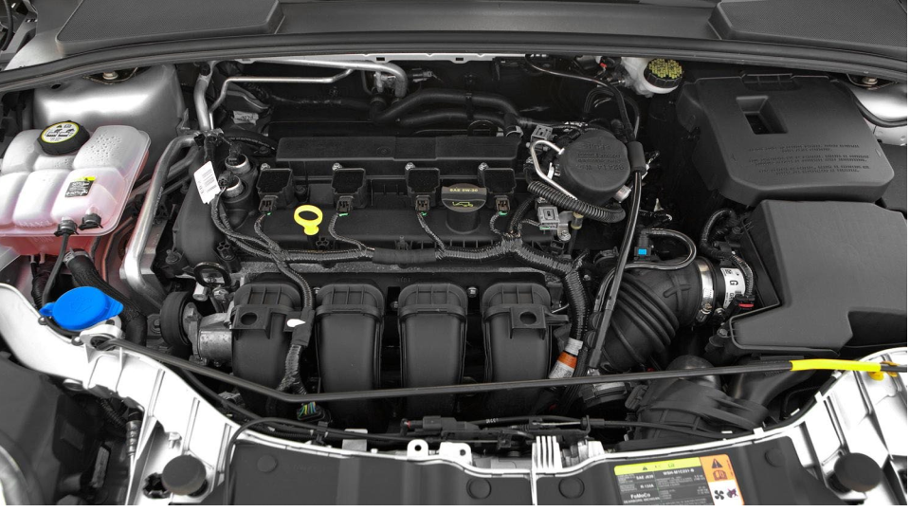






How many cylinders does this car have? What does this mean for the car?
1
2
3
4

Slide 40
References
Used with permission from Western Oregon University. Oregon Driver Risk Prevention Curriculum Playbook. Oregon Department of Transportation.
Consumer reports. How to Save your Neck in a Rear-End Crash.

