Slide 1
Prevention Agenda Year One Implementation Progress Report
Office of Public Health Practice
Notes:
This morning I will provide an update on local efforts to implement interventions to achieve Prevention Agenda goals.
As you will recall, in 2013, in conjunction with the release of the Prevention Agenda, the NYHS DOH asked local health departments and hospitals to conduct a local community health assessment process to identify at least two public health priorities they would work on with their partners, and one health disparity they would address. In December, LHDs and hospitals submitted community health improvement plans and community service plans that identified local, collaboratively identified priorities and described interventions that they would implement to address them. They also identified a health disparity. Today we will be reporting on activities in the first year of implementation.

Slide 2
New York State Health Initiatives
ALIGNMENT:
Improve Population Health
Transform Health Care Delivery
Eliminate Health Disparities
PREVENTION AGENDA
Priority Areas:
- Prevent chronic diseases
- Promote a healthy and safe environment
- Promote healthy women, infants, and children
- Promote mental health and prevent substance abuse
- Prevent HIV, sexually transmitted diseases, vaccine- preventable diseases, health care associated infections
STATE HEALTH INNOVATION PLAN (SHIP)
Pillars and Enablers:
- Improve access to care for all New Yorkers
- Integrate care to address patient needs seamlessly
- Make the cost and quality of care transparent
- Pay for healthcare value, not volume
- Promote population health
- Develop workforce strategy
- Maximize health information technology
- Performance measurement & evaluation
MEDICAID DELIVERY SYSTEM REFORM INCENTIVE PAYMENT (DSRIP) PROGRAM
Key Themes:
- Integrate Delivery – create Performing Provider Systems
- Performance-based payments
- Statewide performance matters
- Regulatory relief and capital funding
- Long-term transformation & health system sustainability
POPULATION HEALTH IMPROVEMENT PROGRAM (PHIP)
PHIP Regional Contractors:
- Identify, share, disseminate, and help implement best practices and strategies to promote population health
- Support and advance the Prevention Agenda
- Support and advance the SHIP
- Serve as resources to DSRIP Performing Provider Systems
Notes:
This update is especially important given the other health reform activities underway in NYS, We have worked with our colleagues in DOH over the past months to support links to the Prevention Agenda and its population health improvement goals.
SHIP/SIM will be reported on later by Hope
DSRIP is the MA Delivery System Reform Incentive Payment program. The Participating provider systems that are part of DSRIP were asked to select project that relate to the Prevention Agenda, I will discuss more on this later in my presentation.
PHIPS – just funded to support engagement of wide range of stakeholders to take action on health reform including PA. All invited to attend today’s meeting.

Slide 3
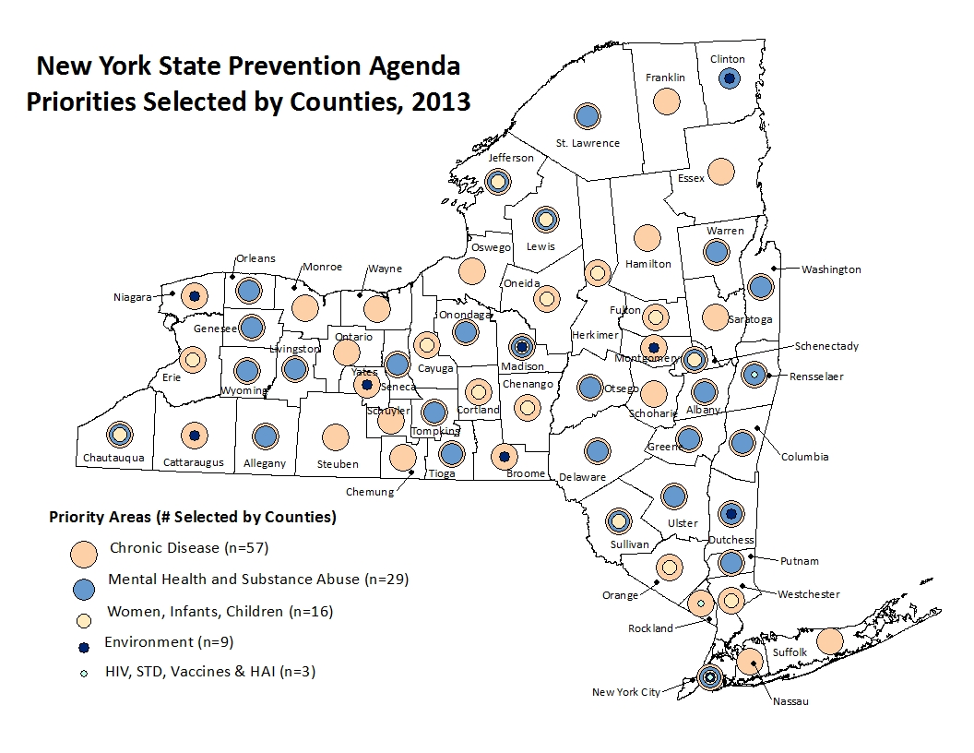
Notes:
This map shows you the priorities selected by the counties a year ago. 57/58 of the counties selected Prevent Chronic Disease as at least one of their priorities, and 29 selected Promote MH and Prevent SA.

Slide 4
Prevention Agenda Year One Progress
170 responses (as of 12/31/2014)
53 out of 58 Local Health Departments
117 Hospital/hospital groups out of 148 CSPs submitted in 2013
340 interventions reported on (2 per survey response)
Information on:
Interventions
Status of efforts
Disparities being addressed
Partners participating
Partnerships organizations require help developing
Successes and challenges
Help Ad Hoc Committee Members take appropriate action
Notes:
Today we will be providing information on first year activities.
This slide set includes data from 53 of the 58 local health departments. Five LHDs had not submitted by the time we started our analysis. It also includes data from 117 hospitals or hospital systems. A year ago, 148 hospitals/hospital systems submitted community service plans. Some had not submitted their updates by the time we started our data analysis. In addition, some hospital systems are reporting on more than one hospital so the number of total reports expected is reduced.
This presentation will provide information on the specific interventions being implemented, the status of implementation, partners at the table and successes and challenges being faced.
This morning we will provide a very high level picture of what we learned. Additional details can be provided by institution, county and region to provide opportunities to organize technical assistance and support additional progress.
The goal of collecting this information is to help you take action to further our efforts!

Slide 5
Notes:
This slide shows you that there are interventions being implemented in all of the priority areas. Almost all LHDs (51) and hospitals (112) that provided one year summaries reported on implementing interventions related to Prevention of Chronic Disease. A large group of LHDs (23) and hospitals (33) are also implementing interventions related to Promoting MH and Preventing SA.
*Note: Except for Prevent Chronic Disease Priority Area, where 38 (32%) hospitals and 11 (21%) LHDs reported on 2 interventions, no more than one intervention for the same priority area was reported by the same organization.

Slide 6
Notes:
Among the LHDs and hospitals working to prevent Chronic Disease, the majority of local health departments and significant numbers of hospitals are working to reduce obesity, while the majority of hospitals and many LHds are working to increase access to evidence based disease management programs. Some of both organizations are also working to address tobacco.

Slide 7
Notes:
In the Promote a Healthy and Safe Environment priority area, the majority of LHDs and hospitals are working on injury prevention while a smaller number are working to improve the built environment. Improving the built environment includes interventions such as Complete Streets initiatives, Smart Growth policies and attention to climate change.

Slide 8
Notes:
In the Healthy Women, Infants and children priority area, the overwhelming number of LHDs and hospitals are focusing attention on maternal and infant health area, which includes attention to preterm birth, breastfeeding and maternal mortality. Smaller numbers are working to increase use of comprehensive well child care and prevention of dental caries, or addressing reproductive health care issues.

Slide 9
Notes:
This slide shows you the focus areas of the LHDs and hospitals working on Promotion of MH and Prevention of Substance Abuse. The majority of organizations are working to strengthen infrastructure across systems, including we think making connections between primary care and behavioral health services, also an important part of DSRIP. We will hear from our colleagues at Office of Mental Health and Office of Alcohol and Substance Abuse services on this a bit later.

Slide 10
Notes:
In the Infections Disease Focus Area, one LHD and 4 hospitals that selected this as their collaborative priority are focusing on HIVs and STDs, four hospitals working on improving vaccination rates and one addressing health care acquired infections. Just because this was not selected by many organizations does not mean these important priorities are not being addressed. Every local health department spends resources working to prevent and address infectious diseases, and many participating provider organizations have selected increasing access to HIV services and retention of care as one of their focus areas in DSRIP.

Slide 11
Notes:
I am now going to show you some slides on the specific interventions that are being implemented in three of the priority areas where there is a lot of work taking place. As a reminder, the state Prevention Agenda plan describes evidence based interventions and promising practices in each priority area that the Ad Hoc Committee and the priority specific committees recommended that communities implement. The interventions were sorted by level of the health impact pyramid to show which strategies would have the biggest effect, and also sorted by type of organization. In the one year update survey tool, we asked LHDs and hospitals to identify two interventions they were making the most progress on, and to describe those. The interventions being implemented include evidence based interventions that increase access to chronic disease self management programs and increase community clinical linkages, as well as a group of LHDs working to adopt healthy food and beverage standards. The “other” category includes activities related to educating the public about the importance of healthy behaviors, encouraging physical activity, and increasing access to chronic disease services.

Slide 12
Notes:
This slide shows you the interventions being implemented by LHDs and hospitals working on Healthy Women, Infants and Children priority area. There were many breastfeeding interventions in the PA plan, including those that focus on increasing breastfeeding in hospitals, work places and primary care offices. These are grouped together here to show you the large number of organizations working on these evidenced based interventions. The Other category here again refers to education to increase access to services as well as education about breastfeeding separate from policy efforts. Finally, there are a handful of organizations reporting work to increase access to prenatal care, decrease preterm birth and integrate preconception and inter-conception care into routine primary care for women.

Slide 13
Notes:
This is the final slide on interventions. Again, there are some organizations working to implement evidence based interventions related to suicide prevention, implementing anti-stigma campaigns and administering a screening, brief intervention and referral to treatment model to identify, reduce and prevent use and abuse of alcohol and illicit drugs. A larger group of organizations are working in “other” areas, which in this case means activities including meetings to promote cross system collaboration to optimize utilization and capacity of services.

Slide 14
Notes:
You will recall that each organization was asked to address at least one disparity. Three quarters of them said that they are doing so.

Slide 15
Notes:
This slide shows you the kinds of disparities being addressed, with the majority addressing disparities related to income and then race and ethnicity or geography, with others also addressing age, disability and gender disparities.
Some of the interventions address more than one priority.

Slide 16
Notes:
We asked LHDs and hospitals to tell us the status of their implementation efforts. Two thirds of LHDs and three quarters of hospitals are on track. We will follow up on those behind schedule or that have not yet started to see how we can support their efforts.

Slide 17
Notes:
LHDs and hospitals were also asked to identify the partners they are working with. The majority of the organizations told us they were working with a pre-existing coalition, for example a regional tobacco coalition that the DOH might fund. Second most frequently they are working with community based organizations. Least frequently they are working with schools, businesses and colleges and universities, which provides opportunities for many of you to join them!

Slide 18
Notes:
In the Chronic Disease priority area, many are working with local coalitions and Community Health centers…..

Slide 19
Notes:
While in the MH/SA area, many are working with governmental partners including the local county mental health offices, which we have been working to encourage, so are pleased with these results!

Slide 20
Notes:
LHDs indicated they would like support getting partners to the table for about ¼ of the interventions while hospitals felt that they needed additional partners for 17% of the interventions.

Slide 21
Notes:
Especially those Health Insurance Plans, faith based organizations, schools, business and media. When we get to the discussion, we would like to talk about how we can address this issue.

Slide 22
Notes:
Finally, we asked about successes and challenges. Many are having successes with their partners and successes in implementing their plans, including setting timetables, milestones, identifying process and outcome measures and collecting data to track progress.

Slide 23
Notes:
At the same time, there is a significant group that needs assistance with data collection, and engaging their community leaders to work on these issues. The other category here refers to organization specific issues that include competing priorities and lack of data.

Slide 24
Notes:
We asked hospitals to comment on the connection between their PA Activities and DSRIP. As you know, the Prevention Agenda has been integrated into DSRIP. Each of the 25 Performing Provider Systems had to select projects to assist them in meeting the DSIRP goals of reducing avoidable hospital use by 25% over five years. These projects are in three different domains including system transformation, clinical improvement and population health. There are clear links between the clinical improvement projects in Domain 3 and the PA. And Domain 4 – population health – is directly related to the PA, with 4 of the five PA priority areas and evidence based interventions from within it. DSRIP asked PPSs to conduct a community needs assessment – something that hospitals and LHDs had just completed fro the PA – and then select projects based on community needs in their regions. The list of projects that have been selected is in your folder. 21/25 of the PPSs selected at least one project addressing chronic disease – cardiovascular health, diabetes, or asthma, accounting for 38 projects. You can also see significant numbers working to strengthen the MHSA Infrastructure, on tobacco cessation and preventive care management, and to increase access and retention of care related to HIV.
Given the connections between DSRIP and the PA, we were interested in learning whether those hospitals that are part of performing provider systems would be using DSRIP to build on their Prevention Agenda activities. You can see that for almost half of the hospitals, they have made a connection between DSRIP and the PA but that for 29% of the hospitals (34), they were unsure and that 14% or 17 hospitals have not. DSRIP partnerships will be strengthened by the partners working on PA goals, and vice versa, so we want to strengthen the connection between these projects as much as possible.

Slide 25
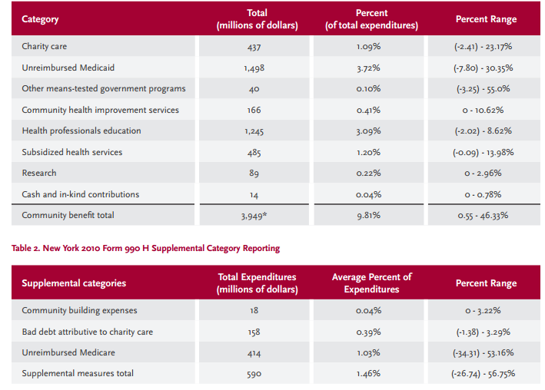
Schedule H Community Benefit Reporting By New York State Hospitals, 2010
Source: New York Academy of Medicine, Achieving the Triple Aim in New York State: the Potential Role of Hospital Community Benefit (Issue Brief June 2014)
Notes:
We also asked hospitals about the connection between their Prevention Agenda activities and their community benefit programs. Schedule H is a form that non profit hospitals must provide annually to the IRS to quality for federal tax exempt status. The form collects information on the kinds of “community benefit” that hospitals invest in in return for tax exemption. The categories of community benefit include charity care and uncompensated care, but also include categories called community health improvement and community building, as shown here. In NY, Commissioner Shah linked community benefit obligations to the Prevention Agenda, and asked hospitals to submit a copy of their “schedule Hs” to us so we could track investments in these areas.
We focus on community health improvement services or community building expenses. These are areas in which hospitals already make investments and we are interested in supporting them to invest in proven approaches in these areas.

Slide 26
Notes:
We asked hospitals whether the interventions described in the survey were also included as investments in Schedule H. 54% of hospitals said they were for at least one intervention, but 21% said no, and 24% were not sure. This is another opportunity to focus attention on the links between these initiatives and a hospital’s obligation to invest in community health. Hospitals already make investments in these areas and we are interested in supporting them to invest in proven approaches in these areas.

Slide 27
What’s Next?
Data for two interventions will be provided by region for individual Local Health Departments and Hospital/Hospital Systems
Intervention progress
Measures used to track progress
Target populations
Disparities being addressed
Partners engaged
Successes and challenges
Notes:
Survey has lots of data that can be analyzed and used to move forward. We plan on giving these data to our partners at NY Academy of Medicine who are invested in developing technical assistance in two key priority areas, as well as to our colleagues in the department and to the population health improvement project colleagues to improve the technical assistance we provide to help local communities move forward toward our shared goals of population health improvement.

Slide 28
Acknowledgements NYAM for helping develop survey tool NYSDOH Division of Chronic Disease for support Office of Public Health Practice staff for data analysis

Slide 29
Questions

